Slide 1
Lecture 2 – Decision Trees
Fnu Suya
08/20/26

Slide 2
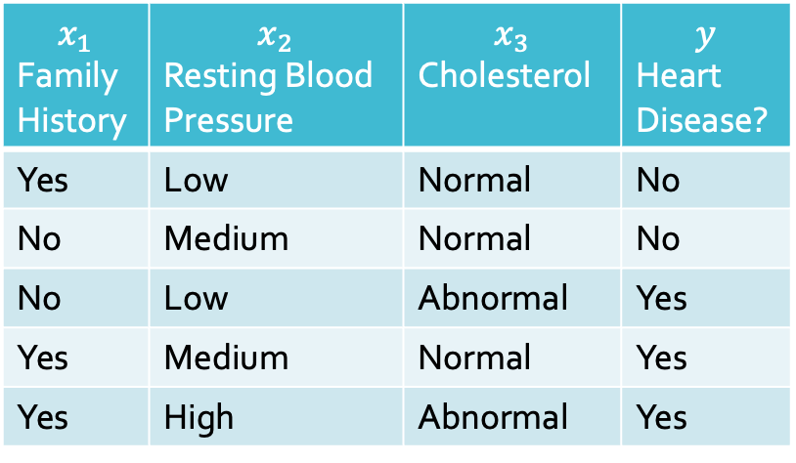
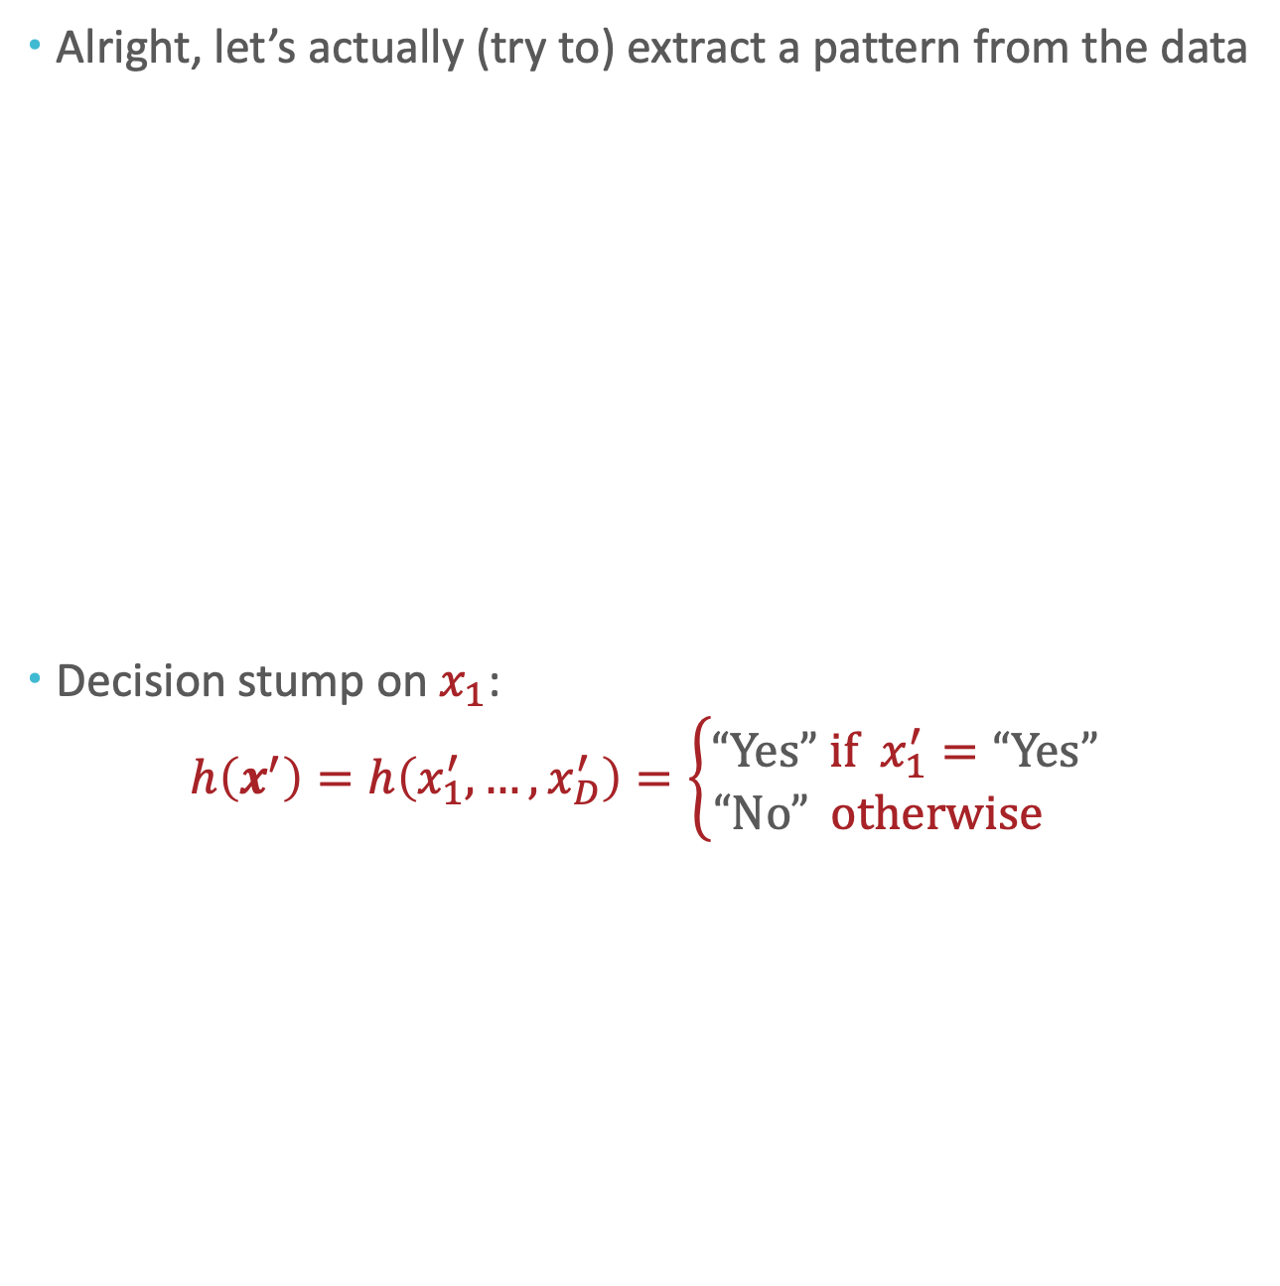
Recall: Our second Machine Learning Classifier
Alright, let’s actually (try to) extract a pattern from the data
Decision stump on $x_{1}$: $h\left(x^{′}\right)=h\left(x_{1}^{′},…,x_{D}^{′}\right)=\left\{\begin{aligned}“Yes” if x_{1}^{′}=“Yes” \\ “No” otherwise \end{aligned}\right.$
$$x_{1}$$ Family History | $$x_{2}$$ Resting Blood Pressure | $$x_{3}$$ Cholesterol | $$y$$ Heart Disease?
Yes | Low | Normal | No
No | Medium | Normal | No
No | Low | Abnormal | Yes
Yes | Medium | Normal | Yes
Yes | High | Abnormal | Yes

Slide 3

Recall: Our second Machine Learning Classifier
Alright, let’s actually (try to) extract a pattern from the data
Decision stump on $x_{1}$: $h\left(x^{′}\right)=h\left(x_{1}^{′},…,x_{D}^{′}\right)=\left\{\begin{aligned}“Yes” if x_{1}^{′}=“Yes” \\ “No” otherwise \end{aligned}\right.$
$$x_{1}$$ Family History | $$x_{2}$$ Resting Blood Pressure | $$x_{3}$$ Cholesterol | $$y$$ Heart Disease?
Yes | Low | Normal | No
No | Medium | Normal | No
No | Low | Abnormal | Yes
Yes | Medium | Normal | Yes
Yes | High | Abnormal | Yes
$$x_{1}$$
“Yes”
“No”
“Yes”
“No”

Slide 4
Decision Stumps: Questions
How can we pick which feature to split on?
Why stop at just one feature?

Slide 5
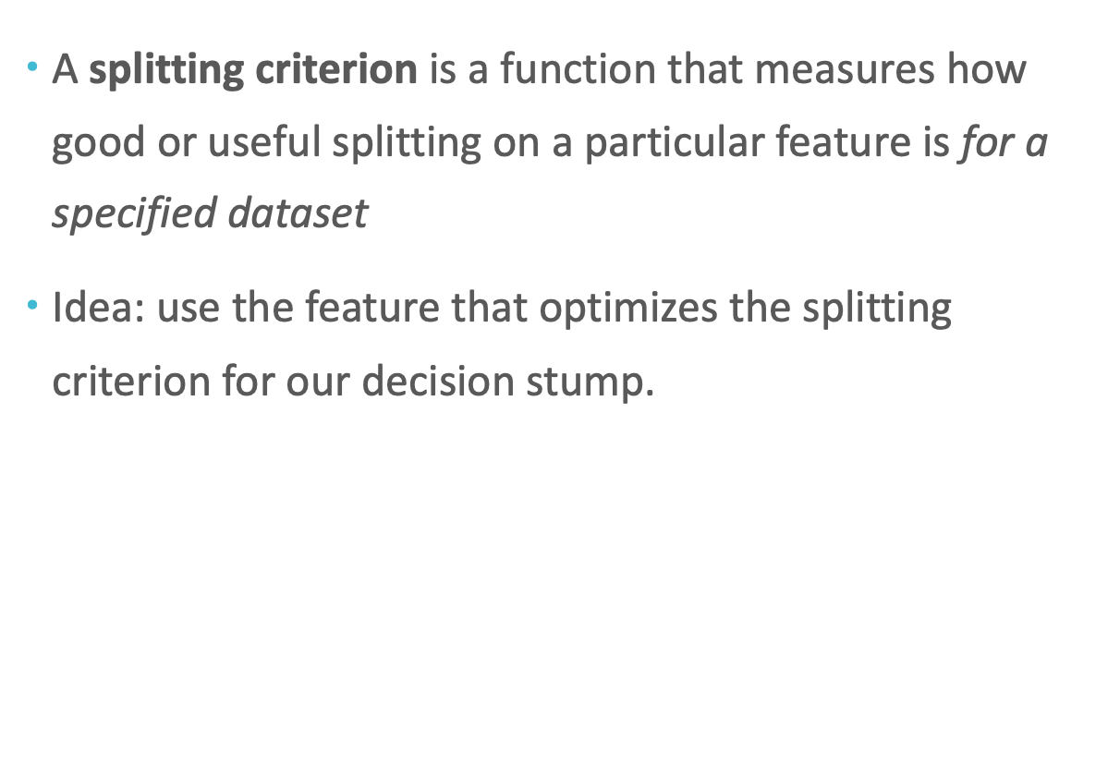
Splitting Criterion
A splitting criterion is a function that measures how good or useful splitting on a particular feature is for a specified dataset
Idea: use the feature that optimizes the splitting criterion for our decision stump.
Potential splitting criteria:
Training error rate (minimize)
Gini impurity (minimize) $→$ CART algorithm
Mutual information (maximize) $→$ ID3 algorithm

Slide 6

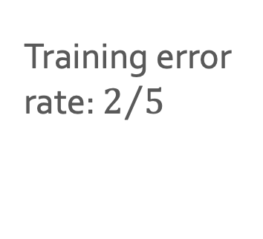


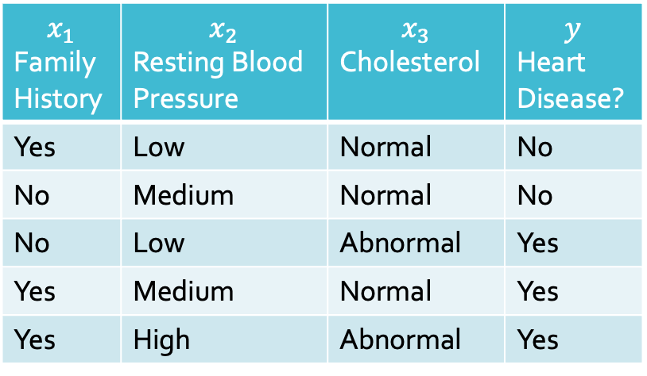
Training error rate as a Splitting Criterion
$$x_{1}$$ Family History | $$x_{2}$$ Resting Blood Pressure | $$x_{3}$$ Cholesterol | $$y$$ Heart Disease?
Yes | Low | Normal | No
No | Medium | Normal | No
No | Low | Abnormal | Yes
Yes | Medium | Normal | Yes
Yes | High | Abnormal | Yes
$$x_{1}$$
$$x_{2}$$
$$x_{3}$$
“Yes”
“No”
“Yes”
“No”
Training error rate: $2/5$
Training error rate:
Training error rate:

Slide 7
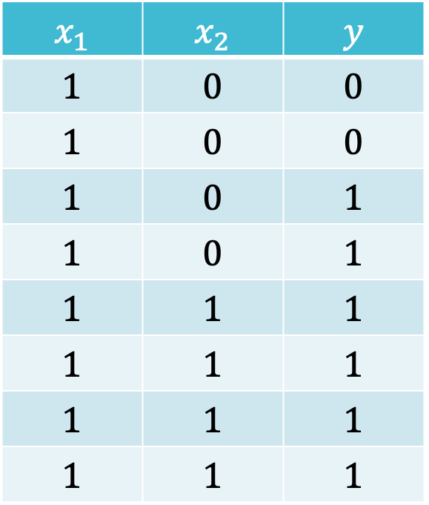


Training error rate as a Splitting Criterion?
Which feature would you split on using training error rate as the splitting criterion?
$$x_{1}$$ | $$x_{2}$$ | $$y$$
$$1$$ | $$0$$ | $$0$$
$$1$$ | $$0$$ | $$0$$
$$1$$ | $$0$$ | $$1$$
$$1$$ | $$0$$ | $$1$$
$$1$$ | $$1$$ | $$1$$
$$1$$ | $$1$$ | $$1$$
$$1$$ | $$1$$ | $$1$$
$$1$$ | $$1$$ | $$1$$
$$x_{1}$$
0
1
$$x_{2}$$
0
1

Slide 8
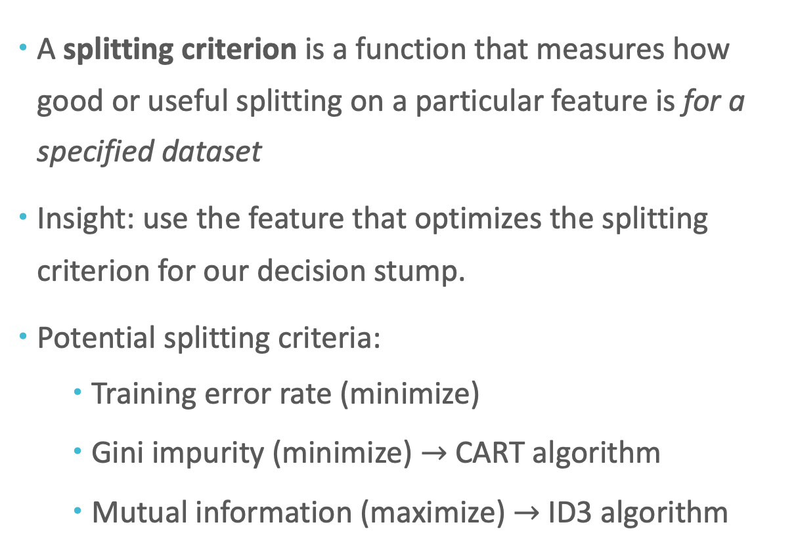
Splitting Criterion
A splitting criterion is a function that measures how good or useful splitting on a particular feature is for a specified dataset
Insight: use the feature that optimizes the splitting criterion for our decision stump.
Potential splitting criteria:
Training error rate (minimize)
Gini impurity (minimize) $→$ CART algorithm
Mutual information (maximize) $→$ ID3 algorithm

Slide 9
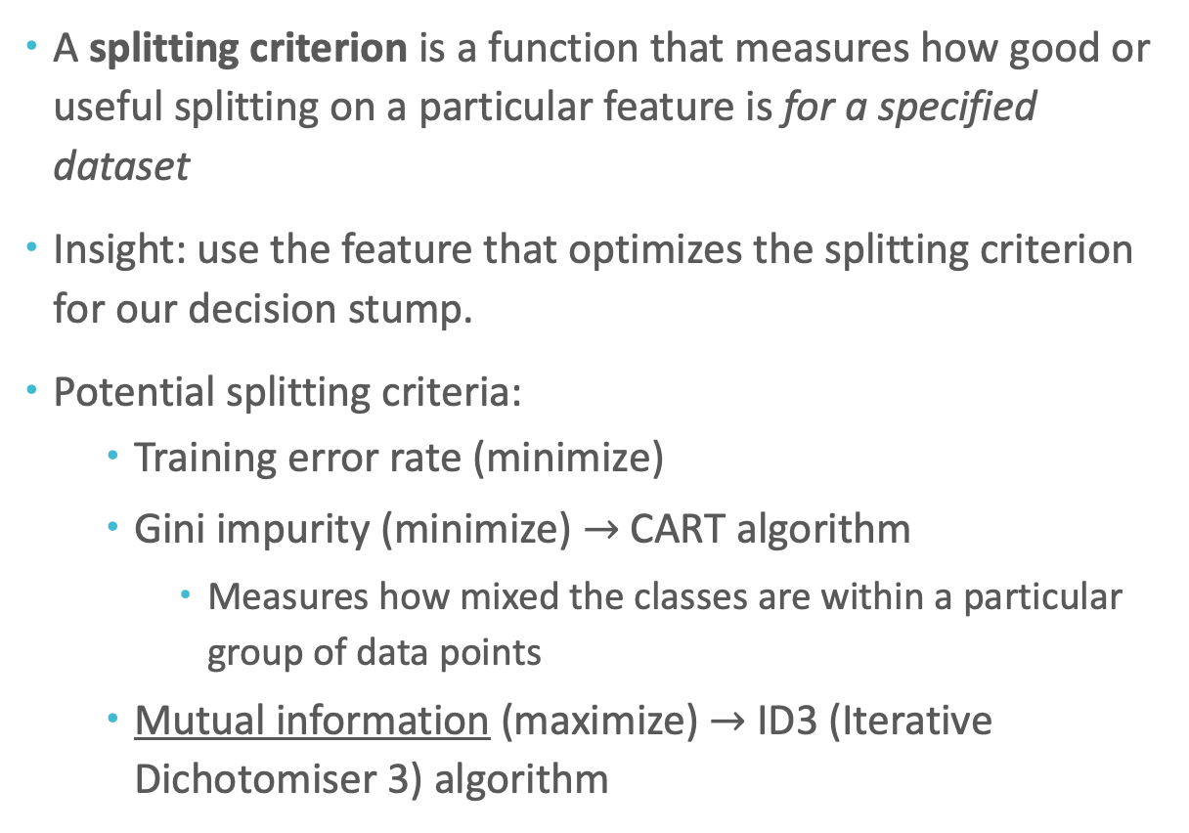
Splitting Criterion
A splitting criterion is a function that measures how good or useful splitting on a particular feature is for a specified dataset
Insight: use the feature that optimizes the splitting criterion for our decision stump.
Potential splitting criteria:
Training error rate (minimize)
Gini impurity (minimize) $→$ CART algorithm
Measures how mixed the classes are within a particular group of data points
Mutual information (maximize) $→$ ID3 (Iterative Dichotomiser 3) algorithm
Notes:
Why training error is not a useful criteria? Because easily, you can have multiple splits with the same split and you cannot tell the difference.

Slide 10
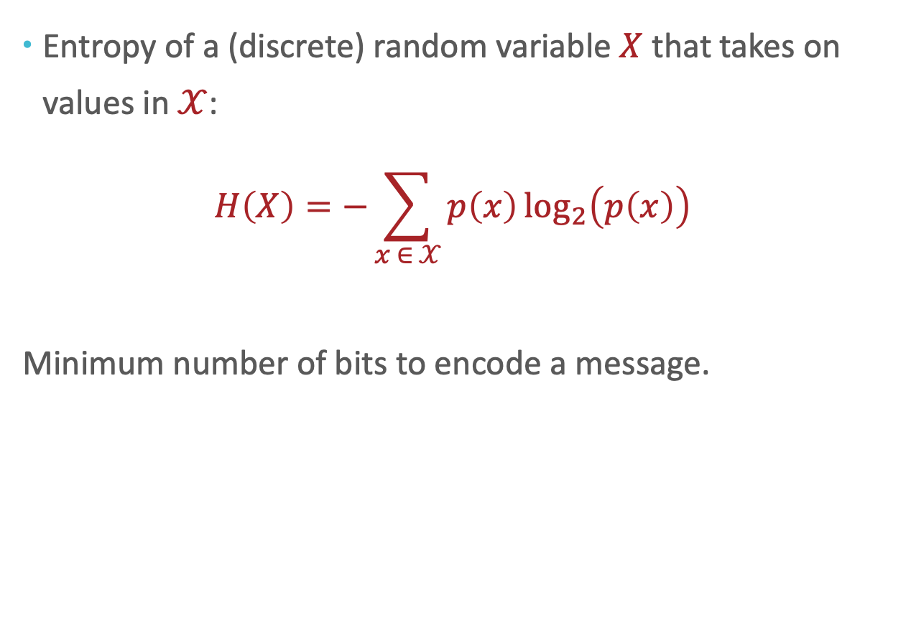
Entropy
Entropy of a (discrete) random variable $X$ that takes on values in $𝒳$:
$$H\left(X\right)=−\sum_{x ∈ 𝒳}{p\left(x\right)\log_{2}\left(p\left(x\right)\right)}$$
Minimum number of bits to encode a message.
Notes:
What about continuous variables? Integral and the pdf function.

Slide 11
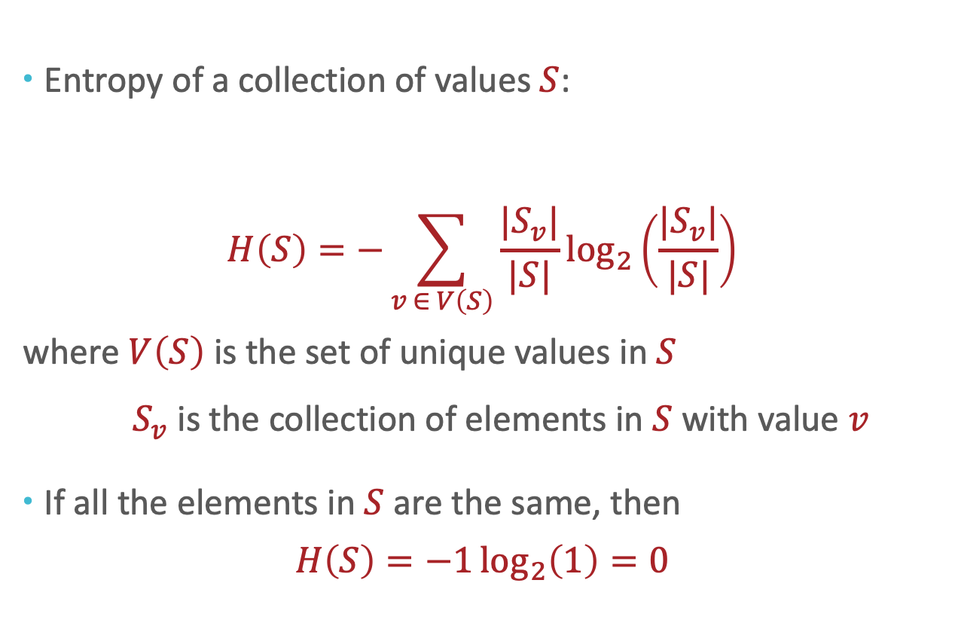
Entropy
Entropy of a collection of values $S$:
$$H\left(S\right)=−\sum_{v ∈ V\left(S\right)}{\frac{|S_{v}|}{|S|}\log_{2}\left(\frac{|S_{v}|}{|S|}\right)}$$
where $V\left(S\right)$ is the set of unique values in $S$
$S_{v}$ is the collection of elements in $S$ with value $v$
If all the elements in $S$ are the same, then
$$H\left(S\right)=−1\log_{2}\left(1\right)=0$$

Slide 12
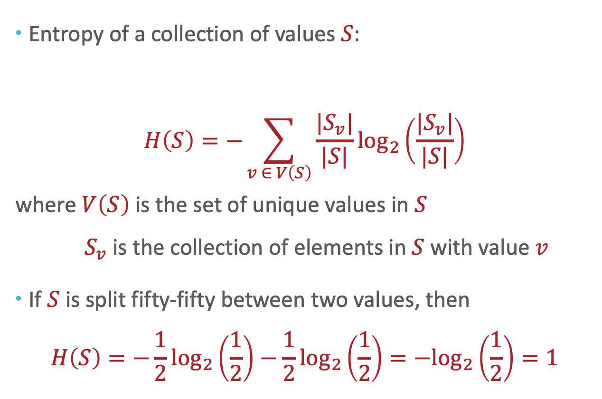
Entropy
Entropy of a collection of values $S$:
$$H\left(S\right)=−\sum_{v ∈ V\left(S\right)}{\frac{|S_{v}|}{|S|}\log_{2}\left(\frac{|S_{v}|}{|S|}\right)}$$
where $V\left(S\right)$ is the set of unique values in $S$
$S_{v}$ is the collection of elements in $S$ with value $v$
If $S$ is split fifty-fifty between two values, then
$$H\left(S\right)=−\frac{1}{2}\log_{2}\left(\frac{1}{2}\right)−\frac{1}{2}\log_{2}\left(\frac{1}{2}\right)=−\log_{2}\left(\frac{1}{2}\right)=1$$
Notes:
So, the entropy is maximized when all outcomes are equal in probability.

Slide 13
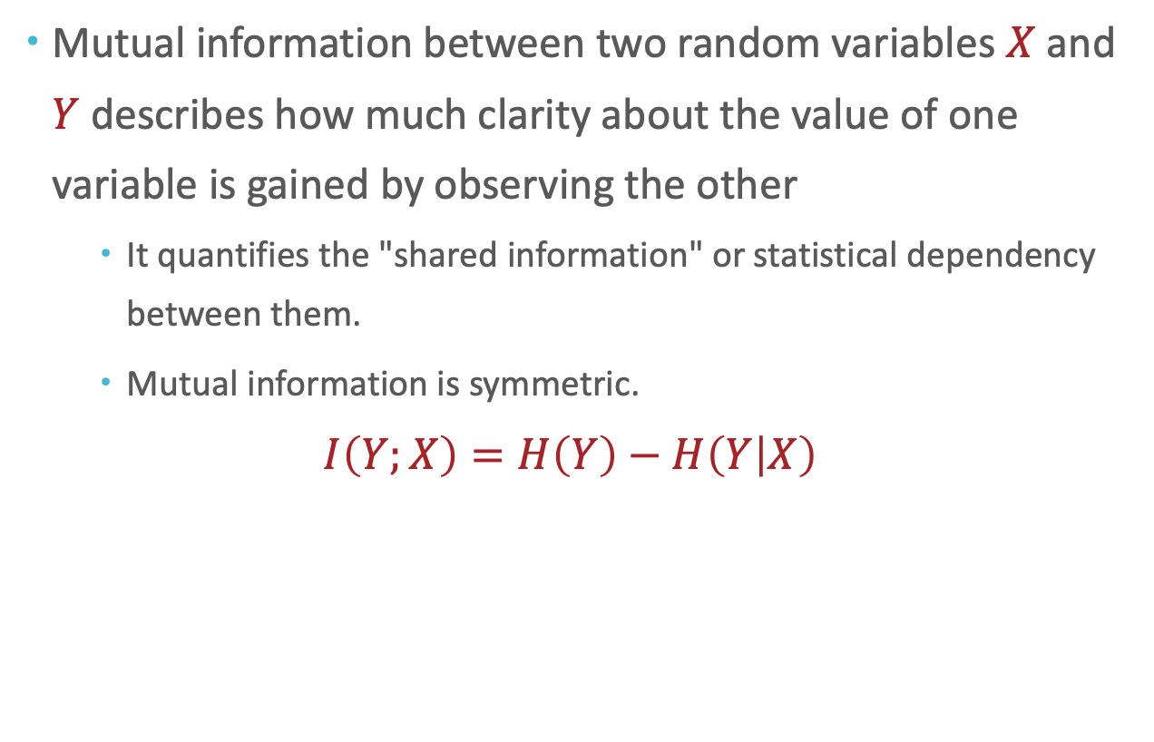
Mutual Information
Mutual information between two random variables $X$ and $Y$ describes how much clarity about the value of one variable is gained by observing the other
It quantifies the "shared information" or statistical dependency between them.
Mutual information is symmetric.
$$I\left(Y;X\right)=H\left(Y\right)−H\left(Y | X\right)$$
Notes:
So entropy can be defined over arbitrary collections; we now turn to a definition more focused on machine learning. When you read the definition of information gain, think about it in terms of datasets with categorical/binary labels and features.

Slide 14
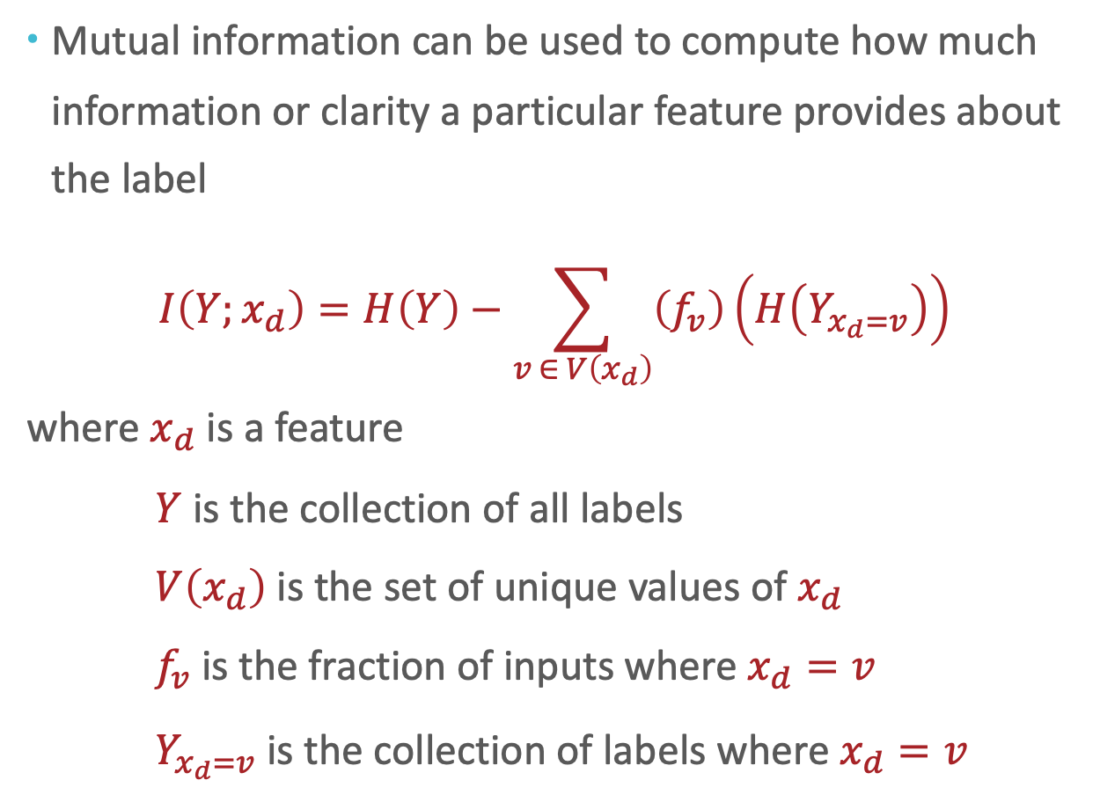
Mutual Information for label prediction
Mutual information can be used to compute how much information or clarity a particular feature provides about the label
$$I\left(Y;x_{d}\right)=H\left(Y\right)−\sum_{v ∈ V\left(x_{d}\right)}{\left(f_{v}\right)\left(H\left(Y_{x_{d}=v}\right)\right)}$$
where $x_{d}$ is a feature
$Y$ is the collection of all labels
$V\left(x_{d}\right)$ is the set of unique values of $x_{d}$
$f_{v}$ is the fraction of inputs where $x_{d}=v$
$Y_{x_{d}=v}$ is the collection of labels where $x_{d}=v$
Notes:
So entropy can be defined over arbitrary collections; we now turn to a definition more focused on machine learning. When you read the definition of information gain, think about it in terms of datasets with categorical/binary labels and features.

Slide 15
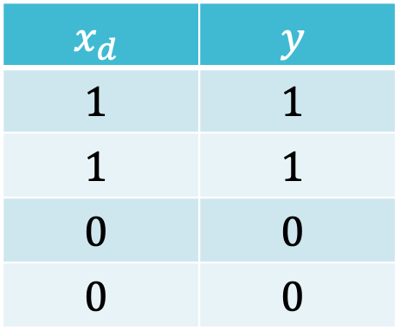
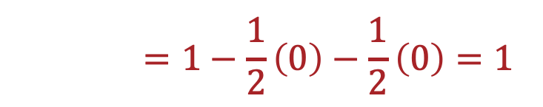
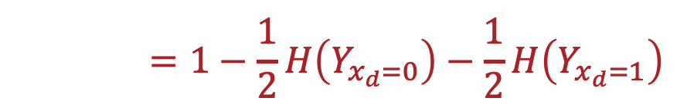
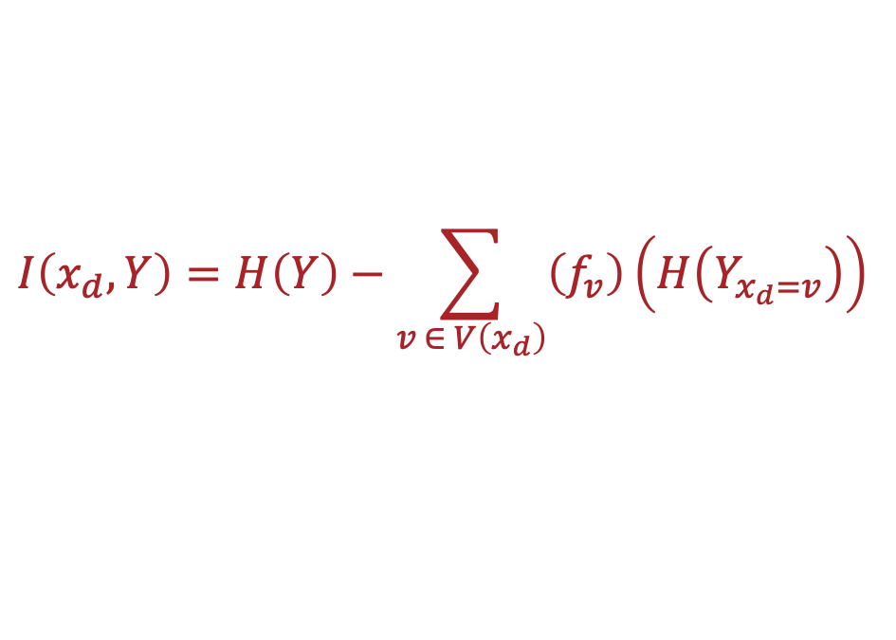
Mutual Information: Example
$$x_{d}$$ | $$y$$
$$1$$ | $$1$$
$$1$$ | $$1$$
$$0$$ | $$0$$
$$0$$ | $$0$$
$$I\left(x_{d},Y\right)=H\left(Y\right)−\sum_{v ∈ V\left(x_{d}\right)}{\left(f_{v}\right)\left(H\left(Y_{x_{d}=v}\right)\right)}$$
$$I\left(x_{d},y\right)=1−\frac{1}{2}H\left(Y_{x_{d}=0}\right)−\frac{1}{2}H\left(Y_{x_{d}=1}\right)$$
$$I\left(x_{d},y\right)=1−\frac{1}{2}\left(0\right)−\frac{1}{2}\left(0\right)=1$$
Notes:
To get some intuition about information gain, we’re going to consider two scenarios that meet the follow criteria
The first is where all inputs where $x_{i}=+1$ have label $y=+1$ and all inputs where $x_{i}=−1$ have label $y=−1$

Slide 16
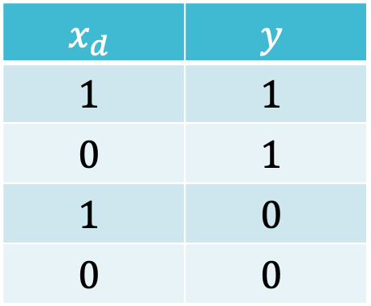
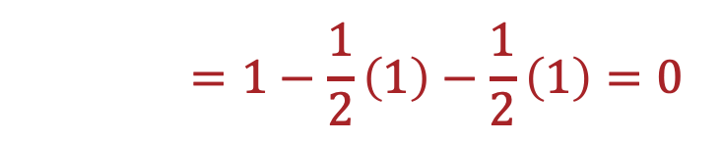
Mutual Information: Example
$$x_{d}$$ | $$y$$
$$1$$ | $$1$$
$$0$$ | $$1$$
$$1$$ | $$0$$
$$0$$ | $$0$$
$$I\left(x_{d},Y\right)=H\left(Y\right)−\sum_{v ∈ V\left(x_{d}\right)}{\left(f_{v}\right)\left(H\left(Y_{x_{d}=v}\right)\right)}$$
$$I\left(x_{d},y\right)=1−\frac{1}{2}H\left(Y_{x_{d}=0}\right)−\frac{1}{2}H\left(Y_{x_{d}=1}\right)$$
$$I\left(x_{d},y\right)=1−\frac{1}{2}\left(1\right)−\frac{1}{2}\left(1\right)=0$$
Notes:
To get some intuition about information gain, we’re going to consider two scenarios that meet the follow criteria
The first is where all inputs where $x_{i}=+1$ have label $y=+1$ and all inputs where $x_{i}=−1$ have label $y=−1$

Slide 17
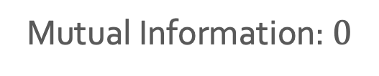

Mutual Information as a Splitting Criterion
Which feature would you split on using mutual information as the splitting criterion?
$$x_{1}$$ | $$x_{2}$$ | $$y$$
$$1$$ | $$0$$ | $$0$$
$$1$$ | $$0$$ | $$0$$
$$1$$ | $$0$$ | $$1$$
$$1$$ | $$0$$ | $$1$$
$$1$$ | $$1$$ | $$1$$
$$1$$ | $$1$$ | $$1$$
$$1$$ | $$1$$ | $$1$$
$$1$$ | $$1$$ | $$1$$
$$x_{1}$$
0
1
0
1
Mutual Information: $0$
$$x_{2}$$
0
1
0
1
Mutual Information: $\left(−\frac{2}{8}\log_{2}{\frac{2}{8}}−\frac{6}{8}\log_{2}{\frac{6}{8}}\right)−\left(\frac{1}{2}\left(1\right)−\frac{1}{2}\left(0\right)\right)≈0.31$

Slide 18
Decision Stumps: Questions
How can we pick which feature to split on?
Why stop at just one feature?

Slide 19
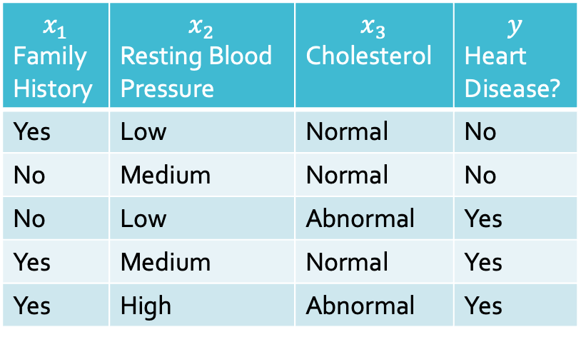

From Decision Stump …
$$x_{3}$$
“Abnormal”
“Normal”
$$x_{1}$$ Family History | $$x_{2}$$ Resting Blood Pressure | $$x_{3}$$ Cholesterol | $$y$$ Heart Disease?
Yes | Low | Normal | No
No | Medium | Normal | No
No | Low | Abnormal | Yes
Yes | Medium | Normal | Yes
Yes | High | Abnormal | Yes
“Yes”
“No”

Slide 20


From Decision Stump to Decision Tree
$$x_{3}$$
“Abnormal”
“Normal”
$$x_{1}$$ Family History | $$x_{2}$$ Resting Blood Pressure | $$x_{3}$$ Cholesterol | $$y$$ Heart Disease?
Yes | Low | Normal | No
No | Medium | Normal | No
No | Low | Abnormal | Yes
Yes | Medium | Normal | Yes
Yes | High | Abnormal | Yes
“Yes”
$$x_{1}$$
“No”
“Yes”
“No”
$$x_{2}$$
“Low”
“Medium/High”
“No”
“Yes”

Slide 21
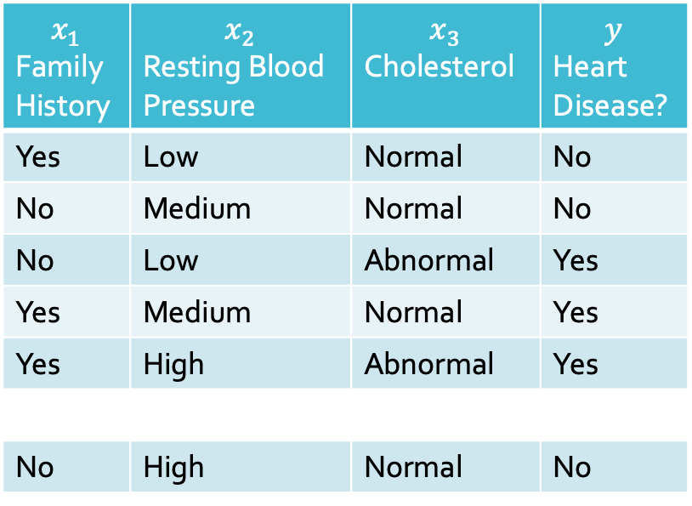
From Decision Stump to Decision Tree
$$x_{3}$$
“Abnormal”
“Normal”
$$x_{1}$$ Family History | $$x_{2}$$ Resting Blood Pressure | $$x_{3}$$ Cholesterol | $$y$$ Heart Disease?
Yes | Low | Normal | No
No | Medium | Normal | No
No | Low | Abnormal | Yes
Yes | Medium | Normal | Yes
Yes | High | Abnormal | Yes
No | High | Normal | No
“Yes”
$$x_{1}$$
“No”
“Yes”
“No”
$$x_{2}$$
“Low”
“Medium/High”
“No”
“Yes”

Slide 22

From Decision Stump to Decision Tree
$$x_{3}$$
“Abnormal”
“Normal”
$$x_{1}$$ Family History | $$x_{2}$$ Resting Blood Pressure | $$x_{3}$$ Cholesterol | $$y$$ Heart Disease?
Yes | Low | Normal | No
No | Medium | Normal | No
No | Low | Abnormal | Yes
Yes | Medium | Normal | Yes
Yes | High | Abnormal | Yes
No | High | Normal | No
“Yes”
$$x_{1}$$
“No”
“Yes”
“No”
$$x_{2}$$
“Low”
“Medium/High”
“No”
“Yes”

Slide 23

From Decision Stump to Decision Tree
$$x_{3}$$
“Abnormal”
“Normal”
$$x_{1}$$ Family History | $$x_{2}$$ Resting Blood Pressure | $$x_{3}$$ Cholesterol | $$y$$ Heart Disease?
Yes | Low | Normal | No
No | Medium | Normal | No
No | Low | Abnormal | Yes
Yes | Medium | Normal | Yes
Yes | High | Abnormal | Yes
No | High | Normal | No
“Yes”
$$x_{1}$$
“No”
“Yes”
“No”
$$x_{2}$$
“Low”
“Medium/High”
“No”
“Yes”

Slide 24
From Decision Stump to Decision Tree
$$x_{3}$$
“Abnormal”
“Normal”
$$x_{1}$$ Family History | $$x_{2}$$ Resting Blood Pressure | $$x_{3}$$ Cholesterol | $$y$$ Heart Disease?
Yes | Low | Normal | No
No | Medium | Normal | No
No | Low | Abnormal | Yes
Yes | Medium | Normal | Yes
Yes | High | Abnormal | Yes
No | High | Normal | No
“Yes”
$$x_{1}$$
“No”
“Yes”
“No”
$$x_{2}$$
“Low”
“Medium/High”
“No”
“Yes”

Slide 25
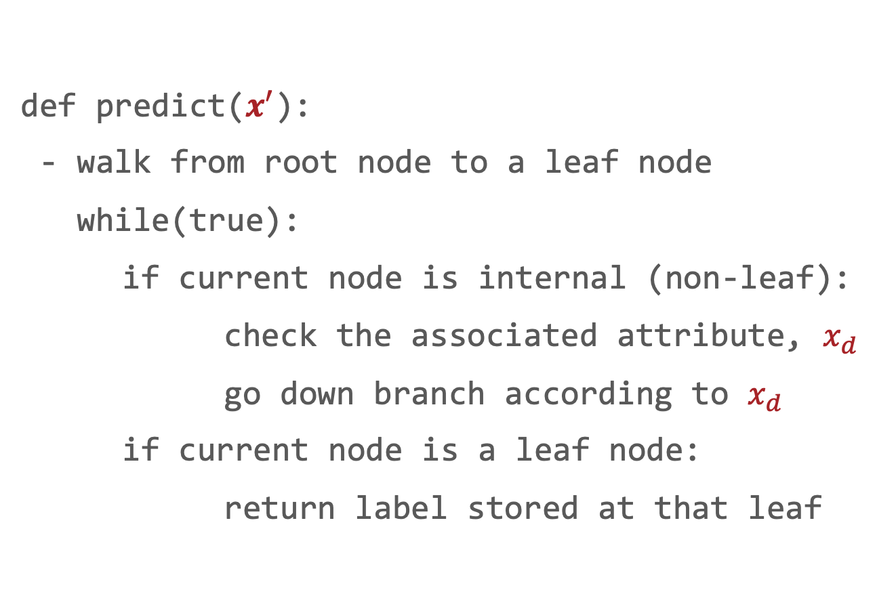
Decision Tree Prediction: Pseudocode
def predict($x^{′}$):
- walk from root node to a leaf node
while(true):
if current node is internal (non-leaf):
check the associated attribute, $x_{d}$
go down branch according to $x_{d}$
if current node is a leaf node:
return label stored at that leaf

Slide 26
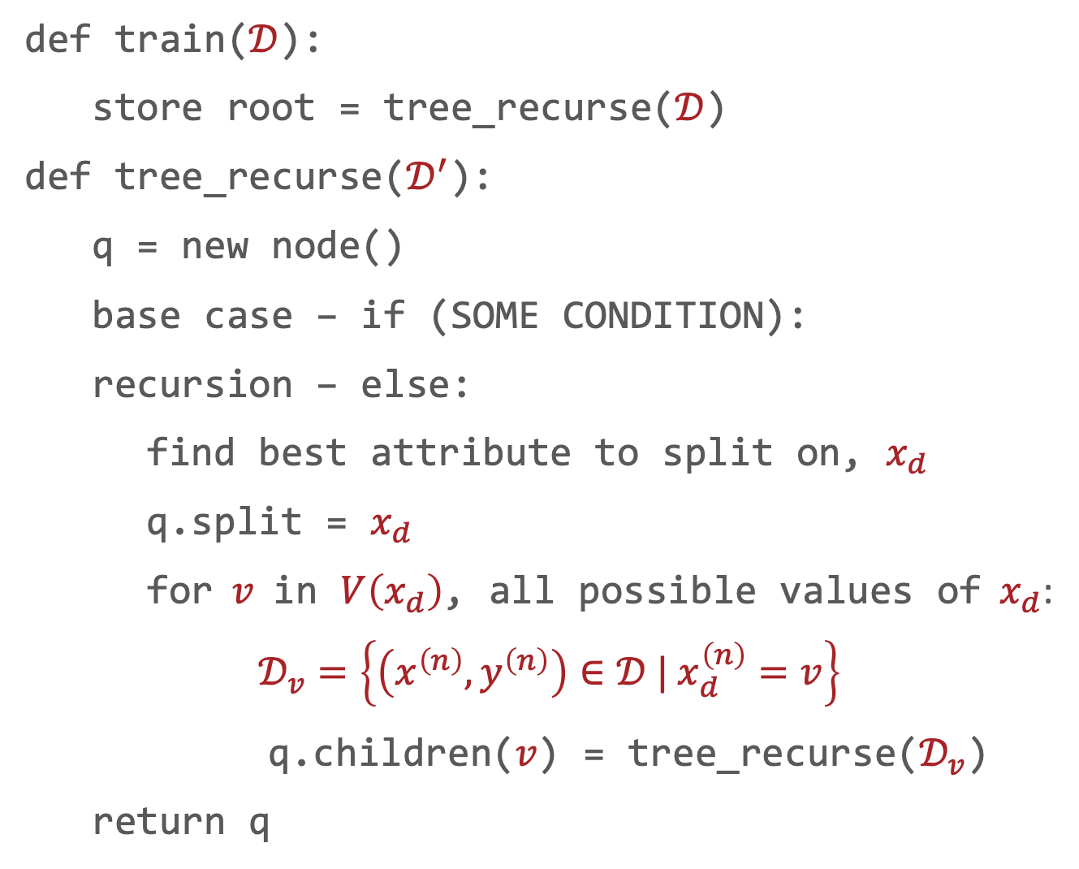
Decision Tree Learning: Pseudocode
def train($𝒟$):
store root = tree_recurse($𝒟$)
def tree_recurse($𝒟^{′}$):
q = new node()
base case – if (SOME CONDITION):
recursion – else:
find best attribute to split on, $x_{d}$
q.split = $x_{d}$
for $v$ in $V\left(x_{d}\right)$, all possible values of $x_{d}$:
$𝒟_{v}=\left\{\left(x^{\left(n\right)},y^{\left(n\right)}\right)∈𝒟 | x_{d}^{\left(n\right)}=v\right\}$
q.children($v$) = tree_recurse($𝒟_{v}$)
return q
Notes:
SOME CONDITION: this is the condition when the recursion stops. And we will discuss it later. When this happens, we usually assign the majority of the labels for data points it contains.
Can you reuse the features previously used? No for categorical features, because very branch you are in contains the same feature values, and hence not informative. However, for continuous features, yes, because it is a threshold and each individual values still have variations in the values. You can use even fine-grained thresholds.

Slide 27
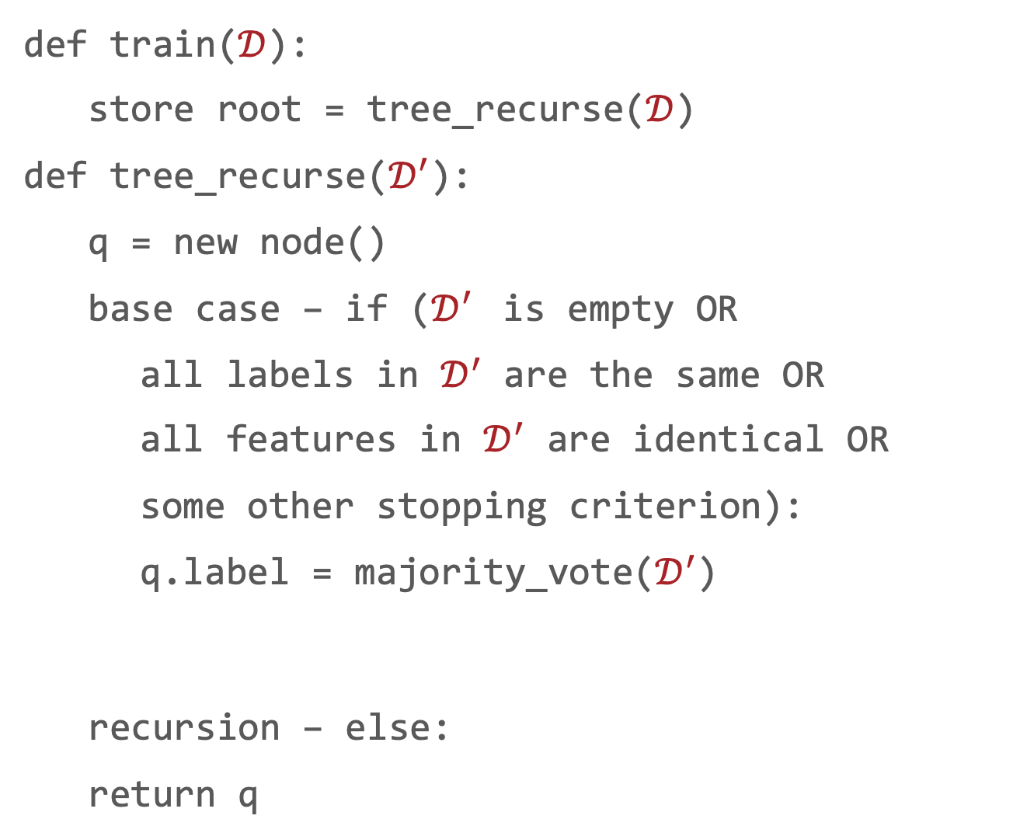
Decision Tree: Pseudocode
def train($𝒟$):
store root = tree_recurse($𝒟$)
def tree_recurse($𝒟^{′}$):
q = new node()
base case – if ($𝒟^{′}$ is empty OR
all labels in $𝒟^{′}$ are the same OR
all features in $𝒟^{′}$ are identical OR
some other stopping criterion):
q.label = majority_vote($𝒟^{′}$)
recursion – else:
return q

Slide 28
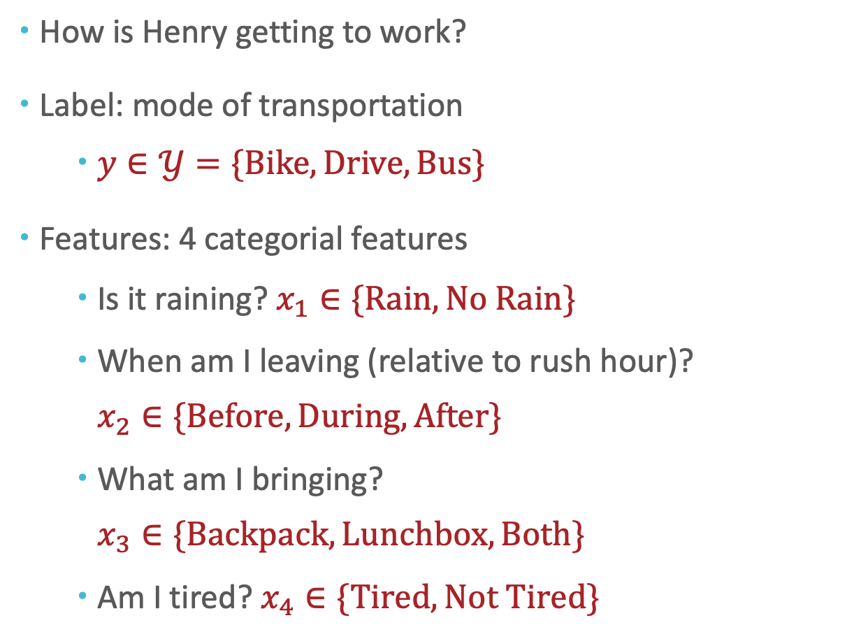
Decision Tree: Example (Iteratively)
How is Henry getting to work?
Label: mode of transportation
$y∈𝒴=\{Bike, Drive, Bus\}$
Features: 4 categorial features
Is it raining? $x_{1}∈\{Rain, No Rain\}$
When am I leaving (relative to rush hour)? $x_{2}∈\{Before, During, After\}$
What am I bringing? $x_{3}∈\{Backpack, Lunchbox, Both\}$
Am I tired? $x_{4}∈\{Tired, Not Tired\}$

Slide 29
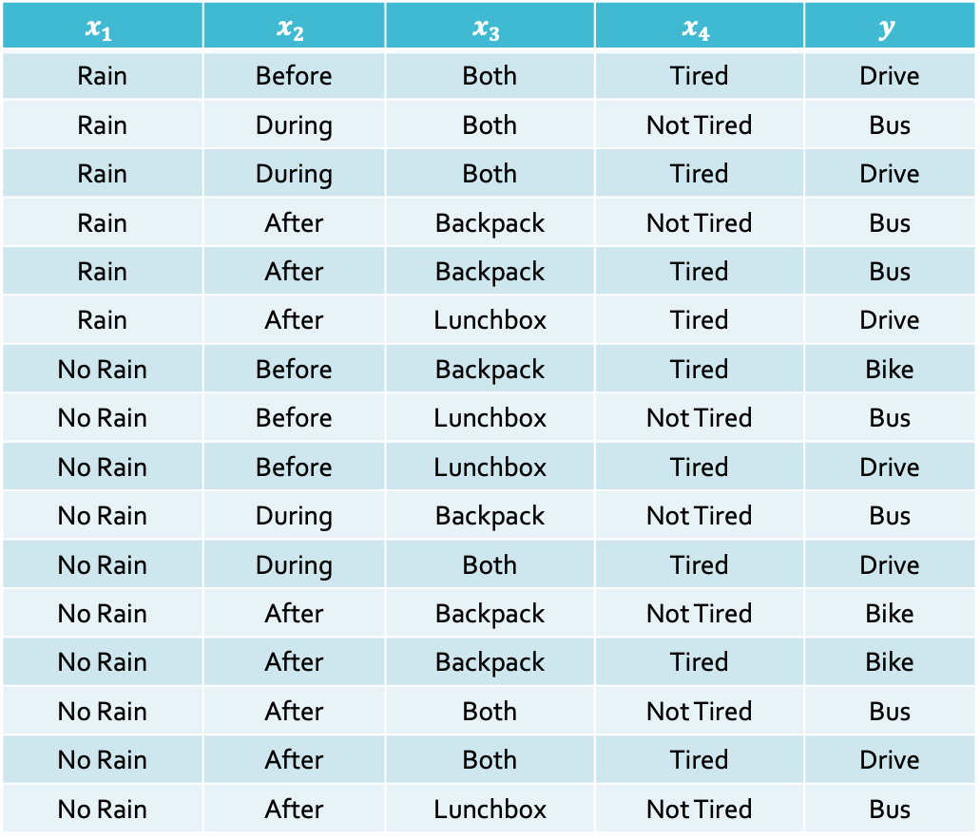
Data
$$x_{1}$$ | $$x_{2}$$ | $$x_{3}$$ | $$x_{4}$$ | $$y$$
Rain | Before | Both | Tired | Drive
Rain | During | Both | Not Tired | Bus
Rain | During | Both | Tired | Drive
Rain | After | Backpack | Not Tired | Bus
Rain | After | Backpack | Tired | Bus
Rain | After | Lunchbox | Tired | Drive
No Rain | Before | Backpack | Tired | Bike
No Rain | Before | Lunchbox | Not Tired | Bus
No Rain | Before | Lunchbox | Tired | Drive
No Rain | During | Backpack | Not Tired | Bus
No Rain | During | Both | Tired | Drive
No Rain | After | Backpack | Not Tired | Bike
No Rain | After | Backpack | Tired | Bike
No Rain | After | Both | Not Tired | Bus
No Rain | After | Both | Tired | Drive
No Rain | After | Lunchbox | Not Tired | Bus

Slide 30

Which feature would we split on first using mutual information as the splitting criterion?
$$x_{1}$$ | $$x_{2}$$ | $$x_{3}$$ | $$x_{4}$$ | $$y$$
Rain | Before | Both | Tired | Drive
Rain | During | Both | Not Tired | Bus
Rain | During | Both | Tired | Drive
Rain | After | Backpack | Not Tired | Bus
Rain | After | Backpack | Tired | Bus
Rain | After | Lunchbox | Tired | Drive
No Rain | Before | Backpack | Tired | Bike
No Rain | Before | Lunchbox | Not Tired | Bus
No Rain | Before | Lunchbox | Tired | Drive
No Rain | During | Backpack | Not Tired | Bus
No Rain | During | Both | Tired | Drive
No Rain | After | Backpack | Not Tired | Bike
No Rain | After | Backpack | Tired | Bike
No Rain | After | Both | Not Tired | Bus
No Rain | After | Both | Tired | Drive
No Rain | After | Lunchbox | Not Tired | Bus

Slide 31
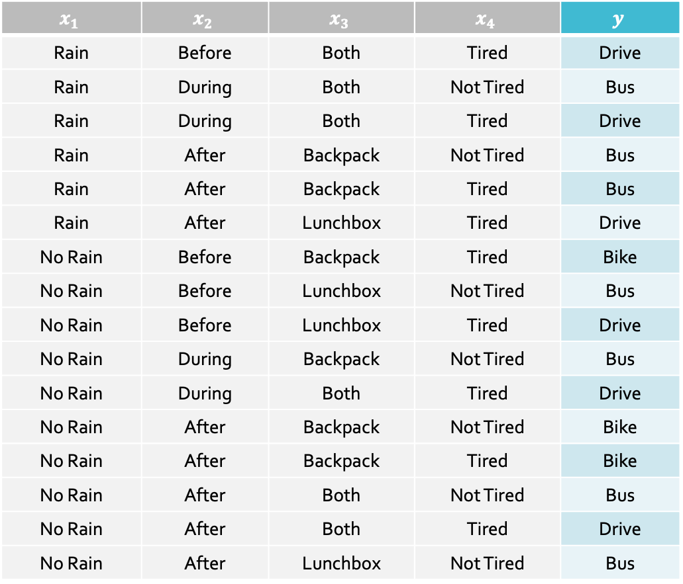


$$H\left(Y\right)=−\frac{3}{16}\log_{2}\left(\frac{3}{16}\right) \\ H\left(Y\right)=−\frac{6}{16}\log_{2}\left(\frac{6}{16}\right) \\ H\left(Y\right)=−\frac{7}{16}\log_{2}\left(\frac{7}{16}\right) \\ H\left(Y\right)≈1.5052$$
Recall: $$H\left(S\right)=−\sum_{v ∈ V\left(S\right)}{\frac{|S_{v}|}{|S|}\log_{2}\left(\frac{|S_{v}|}{|S|}\right)}$$
$$x_{1}$$ | $$x_{2}$$ | $$x_{3}$$ | $$x_{4}$$ | $$y$$
Rain | Before | Both | Tired | Drive
Rain | During | Both | Not Tired | Bus
Rain | During | Both | Tired | Drive
Rain | After | Backpack | Not Tired | Bus
Rain | After | Backpack | Tired | Bus
Rain | After | Lunchbox | Tired | Drive
No Rain | Before | Backpack | Tired | Bike
No Rain | Before | Lunchbox | Not Tired | Bus
No Rain | Before | Lunchbox | Tired | Drive
No Rain | During | Backpack | Not Tired | Bus
No Rain | During | Both | Tired | Drive
No Rain | After | Backpack | Not Tired | Bike
No Rain | After | Backpack | Tired | Bike
No Rain | After | Both | Not Tired | Bus
No Rain | After | Both | Tired | Drive
No Rain | After | Lunchbox | Not Tired | Bus

Slide 32


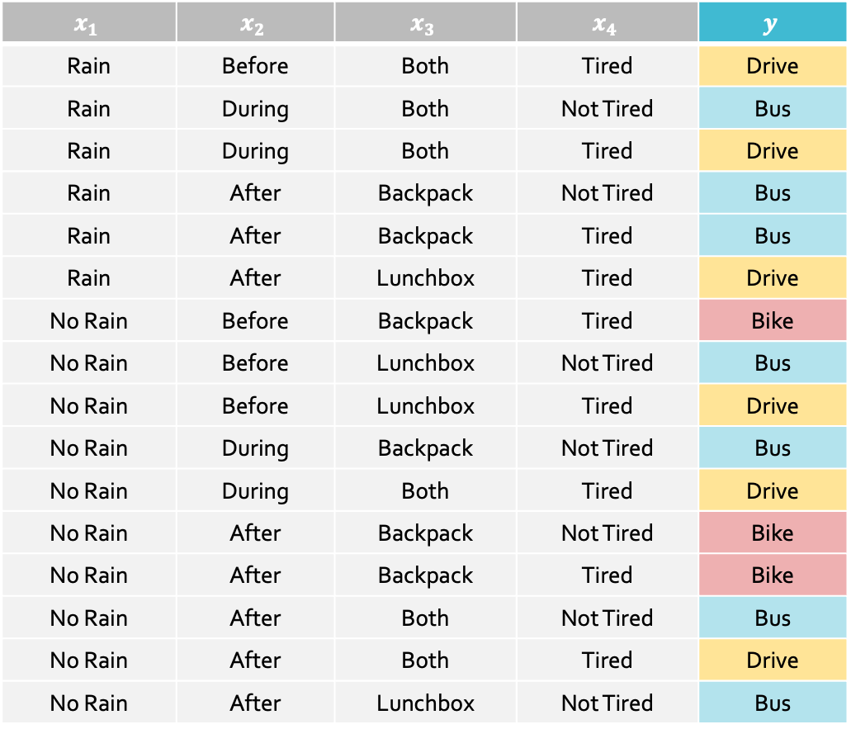
$$H\left(Y\right)=−\frac{3}{16}\log_{2}\left(\frac{3}{16}\right) \\ H\left(Y\right)=−\frac{6}{16}\log_{2}\left(\frac{6}{16}\right) \\ H\left(Y\right)=−\frac{7}{16}\log_{2}\left(\frac{7}{16}\right) \\ H\left(Y\right)≈1.5052$$
Recall: $$H\left(S\right)=−\sum_{v ∈ V\left(S\right)}{\frac{|S_{v}|}{|S|}\log_{2}\left(\frac{|S_{v}|}{|S|}\right)}$$
$$x_{1}$$ | $$x_{2}$$ | $$x_{3}$$ | $$x_{4}$$ | $$y$$
Rain | Before | Both | Tired | Drive
Rain | During | Both | Not Tired | Bus
Rain | During | Both | Tired | Drive
Rain | After | Backpack | Not Tired | Bus
Rain | After | Backpack | Tired | Bus
Rain | After | Lunchbox | Tired | Drive
No Rain | Before | Backpack | Tired | Bike
No Rain | Before | Lunchbox | Not Tired | Bus
No Rain | Before | Lunchbox | Tired | Drive
No Rain | During | Backpack | Not Tired | Bus
No Rain | During | Both | Tired | Drive
No Rain | After | Backpack | Not Tired | Bike
No Rain | After | Backpack | Tired | Bike
No Rain | After | Both | Not Tired | Bus
No Rain | After | Both | Tired | Drive
No Rain | After | Lunchbox | Not Tired | Bus

Slide 33

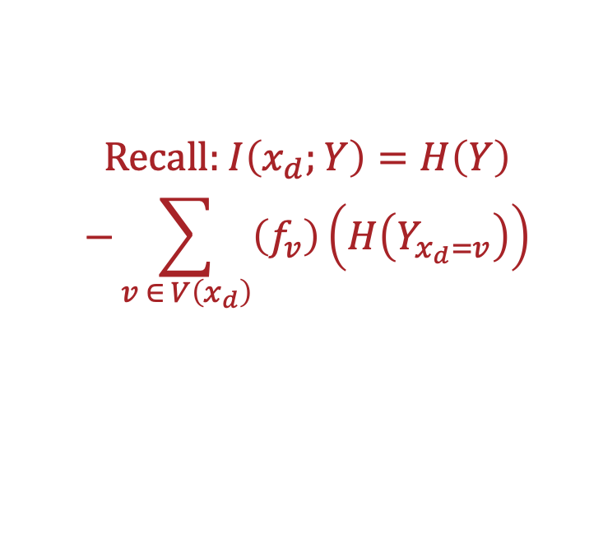
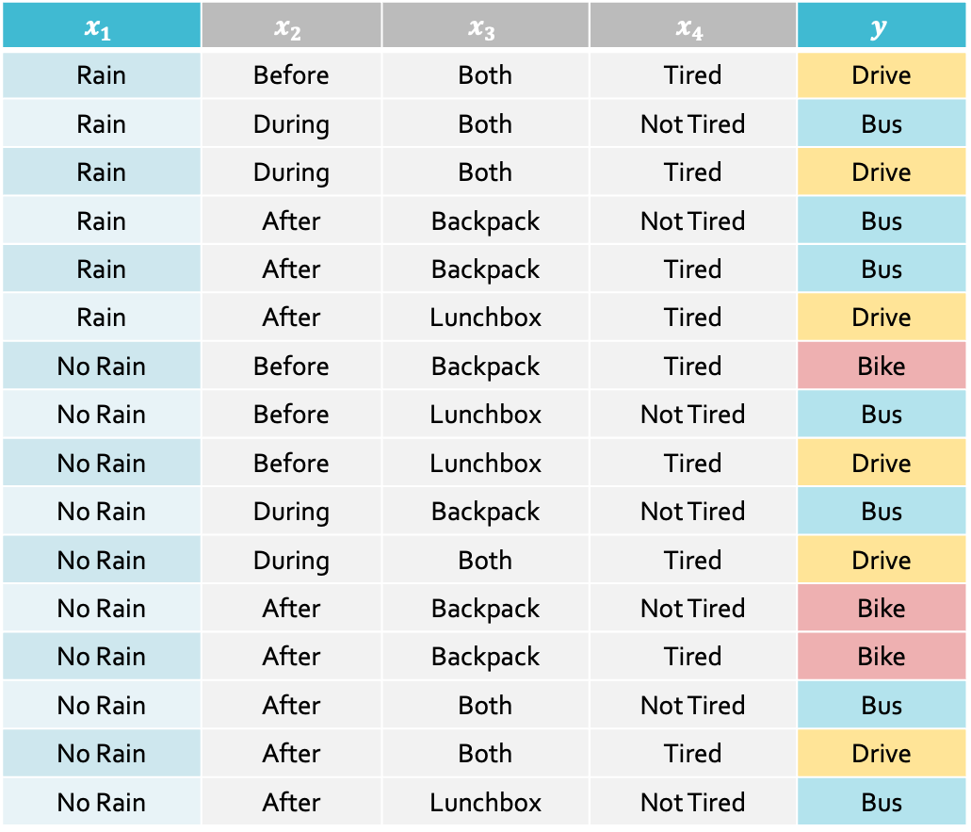
Recall: $I\left(x_{d};Y\right)=H\left(Y\right)$ $$−\sum_{v ∈ V\left(x_{d}\right)}{\left(f_{v}\right)\left(H\left(Y_{x_{d}=v}\right)\right)}$$
$$x_{1}$$ | $$x_{2}$$ | $$x_{3}$$ | $$x_{4}$$ | $$y$$
Rain | Before | Both | Tired | Drive
Rain | During | Both | Not Tired | Bus
Rain | During | Both | Tired | Drive
Rain | After | Backpack | Not Tired | Bus
Rain | After | Backpack | Tired | Bus
Rain | After | Lunchbox | Tired | Drive
No Rain | Before | Backpack | Tired | Bike
No Rain | Before | Lunchbox | Not Tired | Bus
No Rain | Before | Lunchbox | Tired | Drive
No Rain | During | Backpack | Not Tired | Bus
No Rain | During | Both | Tired | Drive
No Rain | After | Backpack | Not Tired | Bike
No Rain | After | Backpack | Tired | Bike
No Rain | After | Both | Not Tired | Bus
No Rain | After | Both | Tired | Drive
No Rain | After | Lunchbox | Not Tired | Bus
$$I\left(x_{1},Y\right)=H\left(Y\right) \\ −\frac{6}{16}\left(−\frac{1}{2}\log_{2}\left(\frac{1}{2}\right)−\frac{1}{2}\log_{2}\left(\frac{1}{2}\right)\right)$$
Notes:
The first term is the second

Slide 34


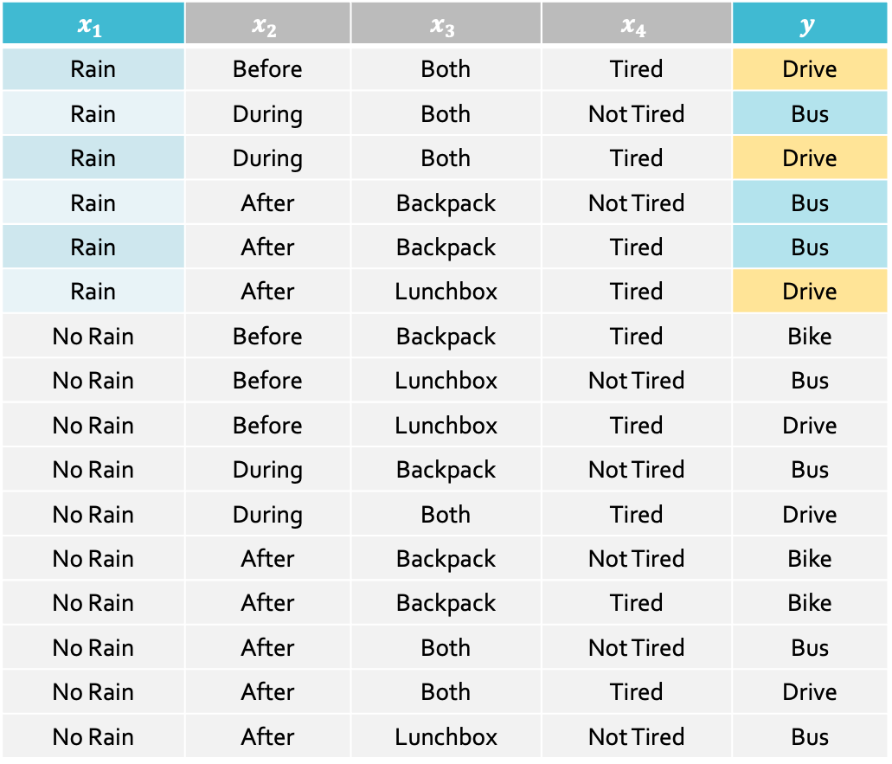
$$I\left(x_{1},Y\right)≈1.5052 \\ −\frac{6}{16}\left(−\frac{1}{2}\log_{2}\left(\frac{1}{2}\right)−\frac{1}{2}\log_{2}\left(\frac{1}{2}\right)\right) \\ −\frac{10}{16}H\left(Y_{x_{d}=No Rain}\right)$$
Recall: $I\left(x_{d};Y\right)=H\left(Y\right)$ $$−\sum_{v ∈ V\left(x_{d}\right)}{\left(f_{v}\right)\left(H\left(Y_{x_{d}=v}\right)\right)}$$
$$x_{1}$$ | $$x_{2}$$ | $$x_{3}$$ | $$x_{4}$$ | $$y$$
Rain | Before | Both | Tired | Drive
Rain | During | Both | Not Tired | Bus
Rain | During | Both | Tired | Drive
Rain | After | Backpack | Not Tired | Bus
Rain | After | Backpack | Tired | Bus
Rain | After | Lunchbox | Tired | Drive
No Rain | Before | Backpack | Tired | Bike
No Rain | Before | Lunchbox | Not Tired | Bus
No Rain | Before | Lunchbox | Tired | Drive
No Rain | During | Backpack | Not Tired | Bus
No Rain | During | Both | Tired | Drive
No Rain | After | Backpack | Not Tired | Bike
No Rain | After | Backpack | Tired | Bike
No Rain | After | Both | Not Tired | Bus
No Rain | After | Both | Tired | Drive
No Rain | After | Lunchbox | Not Tired | Bus

Slide 35

$$I\left(x_{1},Y\right)≈1.5052 \\ −\frac{6}{16}\left(1\right) \\ −\frac{10}{16}H\left(Y_{x_{d}=No Rain}\right)$$
Recall: $I\left(x_{d};Y\right)=H\left(Y\right)$ $$−\sum_{v ∈ V\left(x_{d}\right)}{\left(f_{v}\right)\left(H\left(Y_{x_{d}=v}\right)\right)}$$
$$x_{1}$$ | $$x_{2}$$ | $$x_{3}$$ | $$x_{4}$$ | $$y$$
Rain | Before | Both | Tired | Drive
Rain | During | Both | Not Tired | Bus
Rain | During | Both | Tired | Drive
Rain | After | Backpack | Not Tired | Bus
Rain | After | Backpack | Tired | Bus
Rain | After | Lunchbox | Tired | Drive
No Rain | Before | Backpack | Tired | Bike
No Rain | Before | Lunchbox | Not Tired | Bus
No Rain | Before | Lunchbox | Tired | Drive
No Rain | During | Backpack | Not Tired | Bus
No Rain | During | Both | Tired | Drive
No Rain | After | Backpack | Not Tired | Bike
No Rain | After | Backpack | Tired | Bike
No Rain | After | Both | Not Tired | Bus
No Rain | After | Both | Tired | Drive
No Rain | After | Lunchbox | Not Tired | Bus

Slide 36
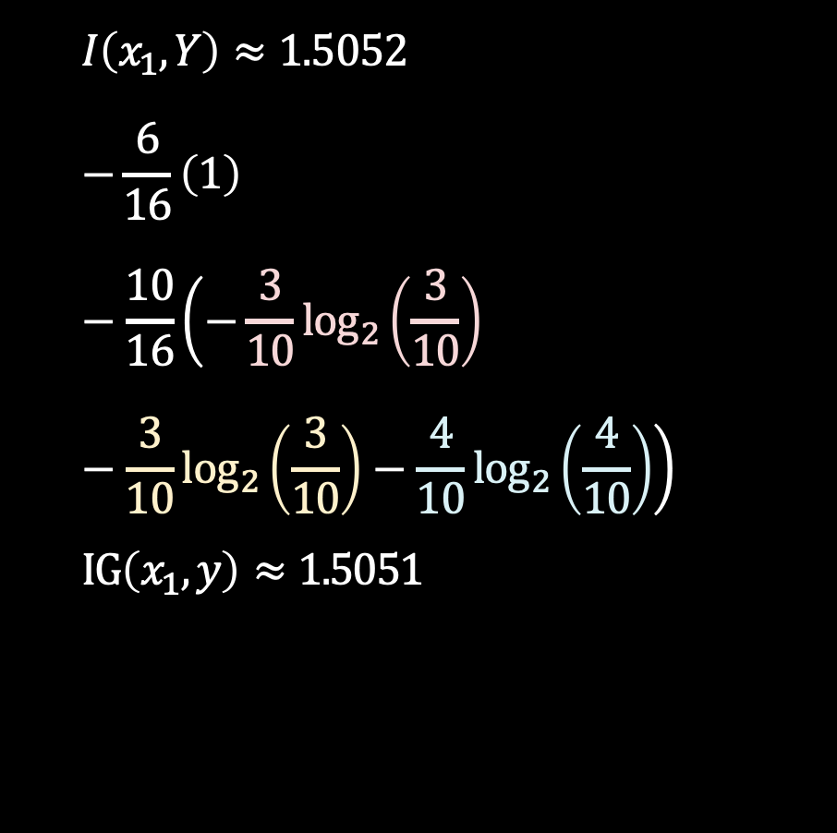
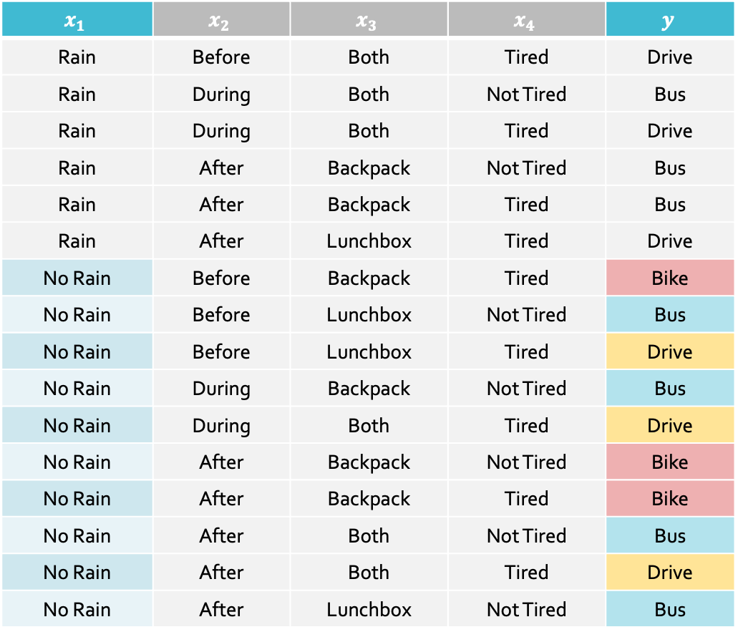
$$I\left(x_{1},Y\right)≈1.5052 \\ −\frac{6}{16}\left(1\right)−\frac{10}{16}\left(−\frac{3}{10}\log_{2}\left(\frac{3}{10}\right)−\frac{3}{10}\log_{2}\left(\frac{3}{10}\right)−\frac{4}{10}\log_{2}\left(\frac{4}{10}\right)\right) \\ IG\left(x_{1},y\right)≈1.5051$$
Recall: $I\left(x_{d};Y\right)=H\left(Y\right)$ $$−\sum_{v ∈ V\left(x_{d}\right)}{\left(f_{v}\right)\left(H\left(Y_{x_{d}=v}\right)\right)}$$
$$x_{1}$$ | $$x_{2}$$ | $$x_{3}$$ | $$x_{4}$$ | $$y$$
Rain | Before | Both | Tired | Drive
Rain | During | Both | Not Tired | Bus
Rain | During | Both | Tired | Drive
Rain | After | Backpack | Not Tired | Bus
Rain | After | Backpack | Tired | Bus
Rain | After | Lunchbox | Tired | Drive
No Rain | Before | Backpack | Tired | Bike
No Rain | Before | Lunchbox | Not Tired | Bus
No Rain | Before | Lunchbox | Tired | Drive
No Rain | During | Backpack | Not Tired | Bus
No Rain | During | Both | Tired | Drive
No Rain | After | Backpack | Not Tired | Bike
No Rain | After | Backpack | Tired | Bike
No Rain | After | Both | Not Tired | Bus
No Rain | After | Both | Tired | Drive
No Rain | After | Lunchbox | Not Tired | Bus

Slide 37

Recall: $I\left(x_{d};Y\right)=H\left(Y\right)$ $$−\sum_{v ∈ V\left(x_{d}\right)}{\left(f_{v}\right)\left(H\left(Y_{x_{d}=v}\right)\right)}$$
$$x_{1}$$ | $$x_{2}$$ | $$x_{3}$$ | $$x_{4}$$ | $$y$$
Rain | Before | Both | Tired | Drive
Rain | During | Both | Not Tired | Bus
Rain | During | Both | Tired | Drive
Rain | After | Backpack | Not Tired | Bus
Rain | After | Backpack | Tired | Bus
Rain | After | Lunchbox | Tired | Drive
No Rain | Before | Backpack | Tired | Bike
No Rain | Before | Lunchbox | Not Tired | Bus
No Rain | Before | Lunchbox | Tired | Drive
No Rain | During | Backpack | Not Tired | Bus
No Rain | During | Both | Tired | Drive
No Rain | After | Backpack | Not Tired | Bike
No Rain | After | Backpack | Tired | Bike
No Rain | After | Both | Not Tired | Bus
No Rain | After | Both | Tired | Drive
No Rain | After | Lunchbox | Not Tired | Bus
$$I\left(x_{1},Y\right)≈1.5052 \\ −\frac{6}{16}\left(1\right) \\ −\frac{10}{16}\left(1.5710\right) \\ I\left(x_{1},Y\right)≈0.1482$$

Slide 38
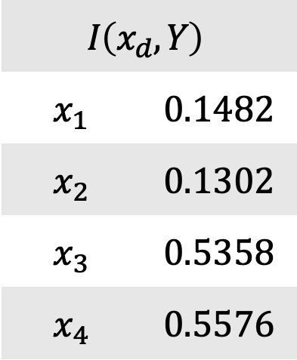
Recall: $I\left(x_{d};Y\right)=H\left(Y\right)$ $$−\sum_{v ∈ V\left(x_{d}\right)}{\left(f_{v}\right)\left(H\left(Y_{x_{d}=v}\right)\right)}$$
$$x_{1}$$ | $$x_{2}$$ | $$x_{3}$$ | $$x_{4}$$ | $$y$$
Rain | Before | Both | Tired | Drive
Rain | During | Both | Not Tired | Bus
Rain | During | Both | Tired | Drive
Rain | After | Backpack | Not Tired | Bus
Rain | After | Backpack | Tired | Bus
Rain | After | Lunchbox | Tired | Drive
No Rain | Before | Backpack | Tired | Bike
No Rain | Before | Lunchbox | Not Tired | Bus
No Rain | Before | Lunchbox | Tired | Drive
No Rain | During | Backpack | Not Tired | Bus
No Rain | During | Both | Tired | Drive
No Rain | After | Backpack | Not Tired | Bike
No Rain | After | Backpack | Tired | Bike
No Rain | After | Both | Not Tired | Bus
No Rain | After | Both | Tired | Drive
No Rain | After | Lunchbox | Not Tired | Bus
$$I\left(x_{d},Y\right)$$
$$x_{1}$$ | $$0.1482$$
$$x_{2}$$ | $$0.1302$$
$$x_{3}$$ | $$0.5358$$
$$x_{4}$$ | $$0.5576$$
Notes:
So, which model to choose? Obviously, x4 to split on.

Slide 39
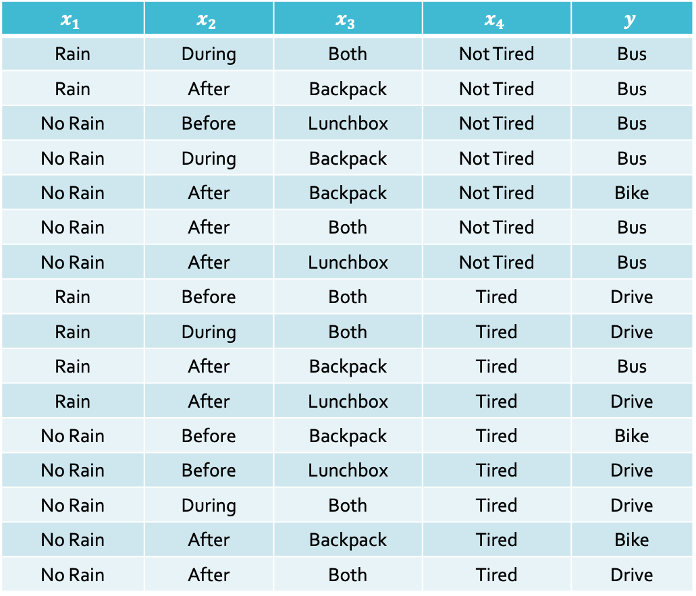

Recall: $I\left(x_{d};Y\right)=H\left(Y\right)$ $$−\sum_{v ∈ V\left(x_{d}\right)}{\left(f_{v}\right)\left(H\left(Y_{x_{d}=v}\right)\right)}$$
$$x_{1}$$ | $$x_{2}$$ | $$x_{3}$$ | $$x_{4}$$ | $$y$$
Rain | During | Both | Not Tired | Bus
Rain | After | Backpack | Not Tired | Bus
No Rain | Before | Lunchbox | Not Tired | Bus
No Rain | During | Backpack | Not Tired | Bus
No Rain | After | Backpack | Not Tired | Bike
No Rain | After | Both | Not Tired | Bus
No Rain | After | Lunchbox | Not Tired | Bus
Rain | Before | Both | Tired | Drive
Rain | During | Both | Tired | Drive
Rain | After | Backpack | Tired | Bus
Rain | After | Lunchbox | Tired | Drive
No Rain | Before | Backpack | Tired | Bike
No Rain | Before | Lunchbox | Tired | Drive
No Rain | During | Both | Tired | Drive
No Rain | After | Backpack | Tired | Bike
No Rain | After | Both | Tired | Drive
$$I\left(x_{d},Y\right)$$
$$x_{1}$$ | $$0.1482$$
$$x_{2}$$ | $$0.1302$$
$$x_{3}$$ | $$0.5358$$
$$x_{4}$$ | $$0.5576$$

Slide 40
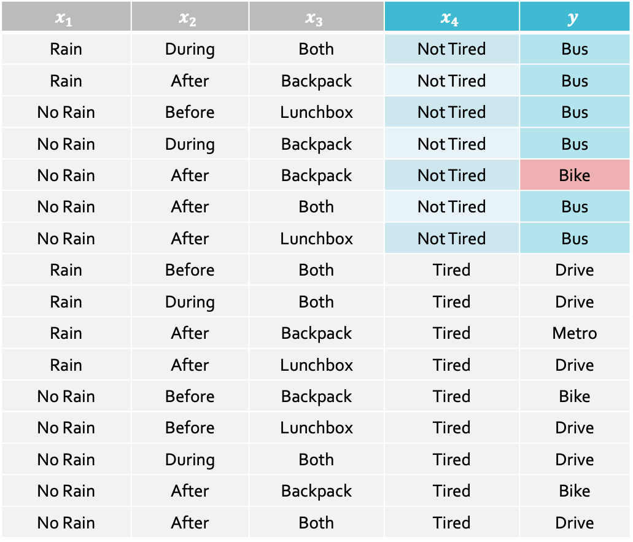
Recall: $I\left(x_{d};Y\right)=H\left(Y\right)$ $$−\sum_{v ∈ V\left(x_{d}\right)}{\left(f_{v}\right)\left(H\left(Y_{x_{d}=v}\right)\right)}$$
$$x_{1}$$ | $$x_{2}$$ | $$x_{3}$$ | $$x_{4}$$ | $$y$$
Rain | During | Both | Not Tired | Bus
Rain | After | Backpack | Not Tired | Bus
No Rain | Before | Lunchbox | Not Tired | Bus
No Rain | During | Backpack | Not Tired | Bus
No Rain | After | Backpack | Not Tired | Bike
No Rain | After | Both | Not Tired | Bus
No Rain | After | Lunchbox | Not Tired | Bus
Rain | Before | Both | Tired | Drive
Rain | During | Both | Tired | Drive
Rain | After | Backpack | Tired | Metro
Rain | After | Lunchbox | Tired | Drive
No Rain | Before | Backpack | Tired | Bike
No Rain | Before | Lunchbox | Tired | Drive
No Rain | During | Both | Tired | Drive
No Rain | After | Backpack | Tired | Bike
No Rain | After | Both | Tired | Drive
$$I\left(x_{d},Y\right)$$
$$x_{1}$$ | $$0.1482$$
$$x_{2}$$ | $$0.1302$$
$$x_{3}$$ | $$0.5358$$
$$x_{4}$$ | $$0.5576$$

Slide 41
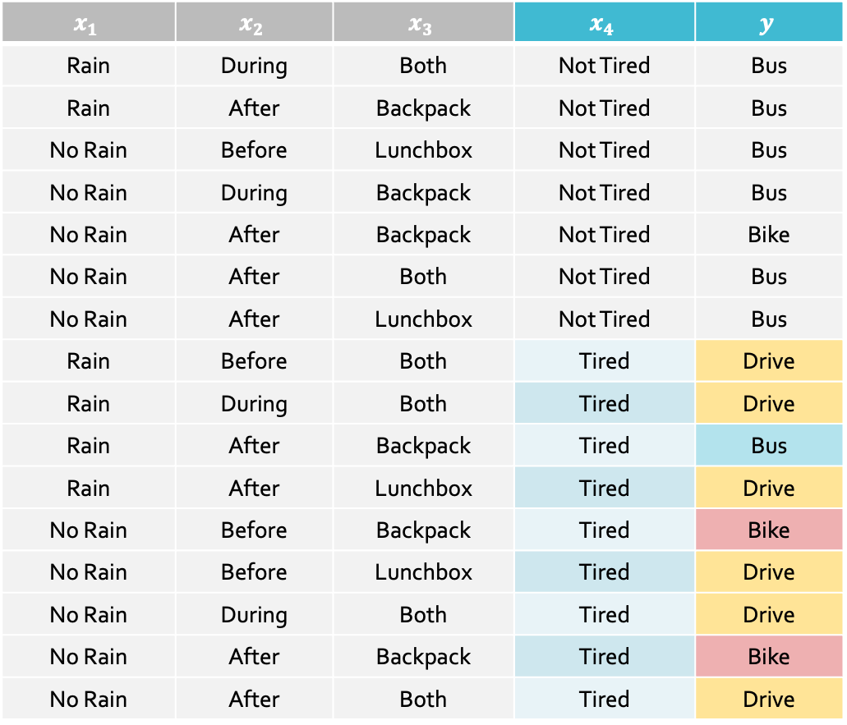

Recall: $I\left(x_{d};Y\right)=H\left(Y\right)$ $$−\sum_{v ∈ V\left(x_{d}\right)}{\left(f_{v}\right)\left(H\left(Y_{x_{d}=v}\right)\right)}$$
$$x_{1}$$ | $$x_{2}$$ | $$x_{3}$$ | $$x_{4}$$ | $$y$$
Rain | During | Both | Not Tired | Bus
Rain | After | Backpack | Not Tired | Bus
No Rain | Before | Lunchbox | Not Tired | Bus
No Rain | During | Backpack | Not Tired | Bus
No Rain | After | Backpack | Not Tired | Bike
No Rain | After | Both | Not Tired | Bus
No Rain | After | Lunchbox | Not Tired | Bus
Rain | Before | Both | Tired | Drive
Rain | During | Both | Tired | Drive
Rain | After | Backpack | Tired | Bus
Rain | After | Lunchbox | Tired | Drive
No Rain | Before | Backpack | Tired | Bike
No Rain | Before | Lunchbox | Tired | Drive
No Rain | During | Both | Tired | Drive
No Rain | After | Backpack | Tired | Bike
No Rain | After | Both | Tired | Drive
$$I\left(x_{d},Y\right)$$
$$x_{1}$$ | $$0.1482$$
$$x_{2}$$ | $$0.1302$$
$$x_{3}$$ | $$0.5358$$
$$x_{4}$$ | $$0.5576$$

Slide 42

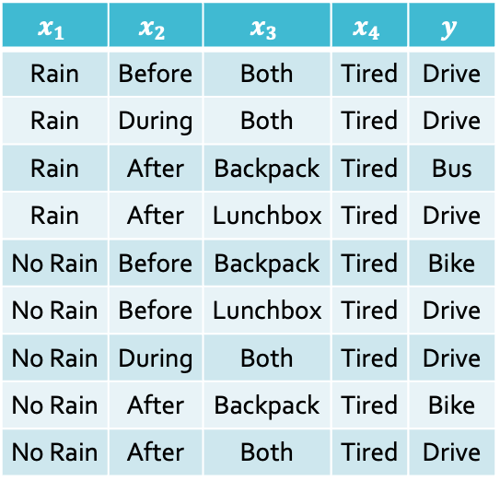
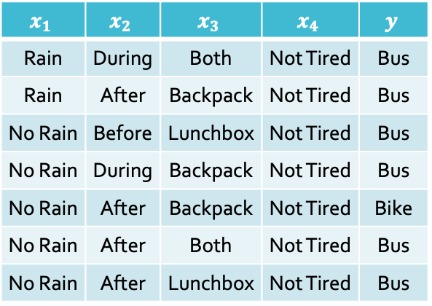
Decision Tree: Example
$$x_{4}$$
Not Tired
Tired
$$x_{1}$$ | $$x_{2}$$ | $$x_{3}$$ | $$x_{4}$$ | $$y$$
Rain | During | Both | Not Tired | Bus
Rain | After | Backpack | Not Tired | Bus
No Rain | Before | Lunchbox | Not Tired | Bus
No Rain | During | Backpack | Not Tired | Bus
No Rain | After | Backpack | Not Tired | Bike
No Rain | After | Both | Not Tired | Bus
No Rain | After | Lunchbox | Not Tired | Bus
$$x_{1}$$ | $$x_{2}$$ | $$x_{3}$$ | $$x_{4}$$ | $$y$$
Rain | Before | Both | Tired | Drive
Rain | During | Both | Tired | Drive
Rain | After | Backpack | Tired | Bus
Rain | After | Lunchbox | Tired | Drive
No Rain | Before | Backpack | Tired | Bike
No Rain | Before | Lunchbox | Tired | Drive
No Rain | During | Both | Tired | Drive
No Rain | After | Backpack | Tired | Bike
No Rain | After | Both | Tired | Drive

Slide 43
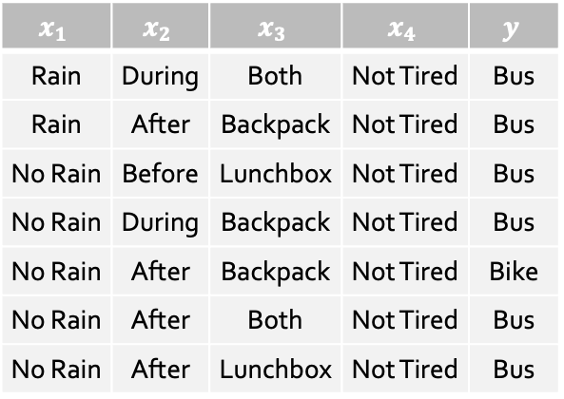
$$x_{4}$$
Not Tired
Tired
$$x_{1}$$ | $$x_{2}$$ | $$x_{3}$$ | $$x_{4}$$ | $$y$$
Rain | During | Both | Not Tired | Bus
Rain | After | Backpack | Not Tired | Bus
No Rain | Before | Lunchbox | Not Tired | Bus
No Rain | During | Backpack | Not Tired | Bus
No Rain | After | Backpack | Not Tired | Bike
No Rain | After | Both | Not Tired | Bus
No Rain | After | Lunchbox | Not Tired | Bus
$$x_{1}$$ | $$x_{2}$$ | $$x_{3}$$ | $$x_{4}$$ | $$y$$
Rain | Before | Both | Tired | Drive
Rain | During | Both | Tired | Drive
Rain | After | Backpack | Tired | Bus
Rain | After | Lunchbox | Tired | Drive
No Rain | Before | Backpack | Tired | Bike
No Rain | Before | Lunchbox | Tired | Drive
No Rain | During | Both | Tired | Drive
No Rain | After | Backpack | Tired | Bike
No Rain | After | Both | Tired | Drive

Slide 44
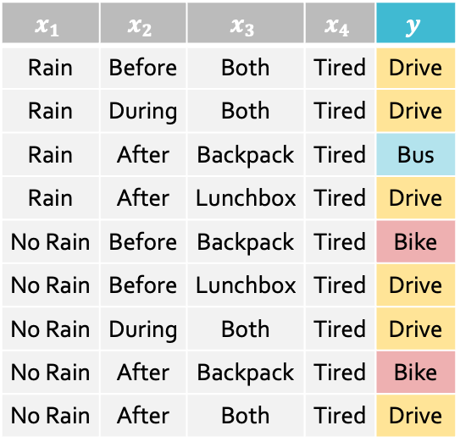

$$H\left(Y_{x_{4}=Tired}\right)=−\frac{6}{9}\log_{2}{\frac{6}{9}}−\frac{2}{9}\log_{2}{\frac{2}{9}}−\frac{1}{9}\log_{2}{\frac{1}{9}}≈1.2244$$
$$x_{4}$$
Not Tired
Tired
$$x_{1}$$ | $$x_{2}$$ | $$x_{3}$$ | $$x_{4}$$ | $$y$$
Rain | During | Both | Not Tired | Bus
Rain | After | Backpack | Not Tired | Bus
No Rain | Before | Lunchbox | Not Tired | Bus
No Rain | During | Backpack | Not Tired | Bus
No Rain | After | Backpack | Not Tired | Bike
No Rain | After | Both | Not Tired | Bus
No Rain | After | Lunchbox | Not Tired | Bus
$$x_{1}$$ | $$x_{2}$$ | $$x_{3}$$ | $$x_{4}$$ | $$y$$
Rain | Before | Both | Tired | Drive
Rain | During | Both | Tired | Drive
Rain | After | Backpack | Tired | Bus
Rain | After | Lunchbox | Tired | Drive
No Rain | Before | Backpack | Tired | Bike
No Rain | Before | Lunchbox | Tired | Drive
No Rain | During | Both | Tired | Drive
No Rain | After | Backpack | Tired | Bike
No Rain | After | Both | Tired | Drive

Slide 45

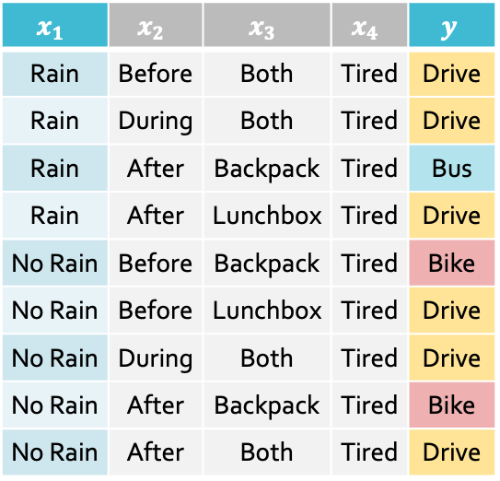
$$I\left(x_{1},Y_{x_{4}=Tired}\right)=H\left(Y_{x_{4}=Tired}\right)−\frac{4}{9}H\left(Y_{x_{4}=Tired, x_{1}=Rain}\right)−\frac{5}{9}H\left(Y_{x_{4}=Tired, x_{1}=No Rain}\right)$$
$$x_{4}$$
Not Tired
Tired
$$x_{1}$$ | $$x_{2}$$ | $$x_{3}$$ | $$x_{4}$$ | $$y$$
Rain | During | Both | Not Tired | Bus
Rain | After | Backpack | Not Tired | Bus
No Rain | Before | Lunchbox | Not Tired | Bus
No Rain | During | Backpack | Not Tired | Bus
No Rain | After | Backpack | Not Tired | Bike
No Rain | After | Both | Not Tired | Bus
No Rain | After | Lunchbox | Not Tired | Bus
$$x_{1}$$ | $$x_{2}$$ | $$x_{3}$$ | $$x_{4}$$ | $$y$$
Rain | Before | Both | Tired | Drive
Rain | During | Both | Tired | Drive
Rain | After | Backpack | Tired | Bus
Rain | After | Lunchbox | Tired | Drive
No Rain | Before | Backpack | Tired | Bike
No Rain | Before | Lunchbox | Tired | Drive
No Rain | During | Both | Tired | Drive
No Rain | After | Backpack | Tired | Bike
No Rain | After | Both | Tired | Drive

Slide 46

$$I\left(x_{1},Y_{x_{4}=Tired}\right)≈1.2244−\frac{4}{9}\left(0.8113\right)−\frac{5}{9}\left(0.9710\right)≈0.3244$$
$$x_{4}$$
Not Tired
Tired
$$x_{1}$$ | $$x_{2}$$ | $$x_{3}$$ | $$x_{4}$$ | $$y$$
Rain | During | Both | Not Tired | Bus
Rain | After | Backpack | Not Tired | Bus
No Rain | Before | Lunchbox | Not Tired | Bus
No Rain | During | Backpack | Not Tired | Bus
No Rain | After | Backpack | Not Tired | Bike
No Rain | After | Both | Not Tired | Bus
No Rain | After | Lunchbox | Not Tired | Bus
$$x_{1}$$ | $$x_{2}$$ | $$x_{3}$$ | $$x_{4}$$ | $$y$$
Rain | Before | Both | Tired | Drive
Rain | During | Both | Tired | Drive
Rain | After | Backpack | Tired | Bus
Rain | After | Lunchbox | Tired | Drive
No Rain | Before | Backpack | Tired | Bike
No Rain | Before | Lunchbox | Tired | Drive
No Rain | During | Both | Tired | Drive
No Rain | After | Backpack | Tired | Bike
No Rain | After | Both | Tired | Drive

Slide 47


$$I\left(x_{1},Y_{x_{4}=Tired}\right)≈0.3244$$
$$I\left(x_{2},Y_{x_{4}=Tired}\right)≈0.2516$$
$$I\left(x_{3},Y_{x_{4}=Tired}\right)≈0.9183$$
$$x_{4}$$
Not Tired
Tired
$$x_{1}$$ | $$x_{2}$$ | $$x_{3}$$ | $$x_{4}$$ | $$y$$
Rain | During | Both | Not Tired | Bus
Rain | After | Backpack | Not Tired | Bus
No Rain | Before | Lunchbox | Not Tired | Bus
No Rain | During | Backpack | Not Tired | Bus
No Rain | After | Backpack | Not Tired | Bike
No Rain | After | Both | Not Tired | Bus
No Rain | After | Lunchbox | Not Tired | Bus
$$x_{1}$$ | $$x_{2}$$ | $$x_{3}$$ | $$x_{4}$$ | $$y$$
Rain | Before | Both | Tired | Drive
Rain | During | Both | Tired | Drive
Rain | After | Backpack | Tired | Bus
Rain | After | Lunchbox | Tired | Drive
No Rain | Before | Backpack | Tired | Bike
No Rain | Before | Lunchbox | Tired | Drive
No Rain | During | Both | Tired | Drive
No Rain | After | Backpack | Tired | Bike
No Rain | After | Both | Tired | Drive

Slide 48


$$I\left(x_{1},Y_{x_{4}=Tired}\right)≈0.3244$$
$$I\left(x_{2},Y_{x_{4}=Tired}\right)≈0.2516$$
$$I\left(x_{3},Y_{x_{4}=Tired}\right)≈0.9183$$
$$x_{4}$$
Not Tired
Tired
$$x_{1}$$ | $$x_{2}$$ | $$x_{3}$$ | $$x_{4}$$ | $$y$$
Rain | During | Both | Not Tired | Bus
Rain | After | Backpack | Not Tired | Bus
No Rain | Before | Lunchbox | Not Tired | Bus
No Rain | During | Backpack | Not Tired | Bus
No Rain | After | Backpack | Not Tired | Bike
No Rain | After | Both | Not Tired | Bus
No Rain | After | Lunchbox | Not Tired | Bus
$$x_{1}$$ | $$x_{2}$$ | $$x_{3}$$ | $$x_{4}$$ | $$y$$
Rain | After | Backpack | Tired | Bus
No Rain | Before | Backpack | Tired | Bike
No Rain | After | Backpack | Tired | Bike
Rain | Before | Both | Tired | Drive
Rain | During | Both | Tired | Drive
No Rain | During | Both | Tired | Drive
No Rain | After | Both | Tired | Drive
Rain | After | Lunchbox | Tired | Drive
No Rain | Before | Lunchbox | Tired | Drive

Slide 49


$$I\left(x_{1},Y_{x_{4}=Tired}\right)≈0.3244$$
$$I\left(x_{2},Y_{x_{4}=Tired}\right)≈0.2516$$
$$I\left(x_{3},Y_{x_{4}=Tired}\right)≈0.9183$$
$$x_{4}$$
Not Tired
Tired
$$x_{1}$$ | $$x_{2}$$ | $$x_{3}$$ | $$x_{4}$$ | $$y$$
Rain | During | Both | Not Tired | Bus
Rain | After | Backpack | Not Tired | Bus
No Rain | Before | Lunchbox | Not Tired | Bus
No Rain | During | Backpack | Not Tired | Bus
No Rain | After | Backpack | Not Tired | Bike
No Rain | After | Both | Not Tired | Bus
No Rain | After | Lunchbox | Not Tired | Bus
$$x_{3}$$
Backpack
Both, Lunchbox
$$x_{1}$$ | $$x_{2}$$ | $$y$$
Rain | After | Bus
No Rain | Before | Bike
No Rain | After | Bike
Drive

Slide 50






$$x_{4}$$
Not Tired
Tired
$$x_{3}$$
$$x_{3}$$
Backpack
Both, Lunchbox
Backpack
Both, Lunchbox
$$x_{1}$$
Bus
$$x_{1}$$
Drive
No Rain
Rain
No Rain
Rain
$$x_{2}$$
Bus
Bike
Bus
Before, After
During
Bike
Bus

Slide 51
Decision Trees: Inductive Bias
The inductive bias of a machine learning algorithm is the principal by which it generalizes to unseen examples
What is the inductive bias of the ID3 algorithm i.e., decision tree learning with mutual information maximization as the splitting criterion?
Occam’s razor: try to find the “simplest” (e.g., smallest decision tree) classifier that explains the training dataset
Notes:
An inductive bias is the set of assumptions a machine learning algorithm uses to predict answers for new, unseen data based on limited training examples. DT assumes data can be split into hierarchical orders.

Slide 52
Decision Trees: Pros & Cons
Pros
Interpretable
Efficient (computational cost and storage)
Can be used for classification and regression tasks
Compatible with categorical and real-valued features
Cons
Learned greedily: each split only considers the immediate impact on the splitting criterion
Not guaranteed to find the smallest (fewest number of splits) tree that achieves a training error rate of 0.
Liable to overfit!
Notes:
In a regression tree, the goal is to create nodes where the target values are as similar as possible. The most common splitting criterion is variance reduction. The algorithm chooses the split that results in the largest drop in variance of the target variable. Minimizing variance is equivalent to minimizing the Mean Squared Error (MSE) relative to the mean of the samples in a node.
The final prediction for DR regression tasks is returning the averaged regression values of the train data in that lead node.

Slide 53




Real-Valued Features: Example - $x=$ Outside Temperature (℉)
$$x$$ | $$y$$
74 | Drive
55 | Metro
63 | Bike
33 | Drive
80 | Drive
81 | Drive
44 | Metro
45 | Metro
78 | Drive
51 | Metro
$$x$$ | $$y$$
33 | Drive
44 | Metro
45 | Metro
51 | Metro
55 | Metro
63 | Bike
74 | Drive
78 | Drive
80 | Drive
81 | Drive
$$x<38.5$$
Notes:
Suppose temperature had been one of our features

Slide 54

Real-Valued Features: Example - $x=$ Outside Temperature (℉)
$$x$$ | $$y$$
74 | Drive
55 | Metro
63 | Bike
33 | Drive
80 | Drive
81 | Drive
44 | Metro
45 | Metro
78 | Drive
51 | Metro
$$x$$ | $$y$$
33 | Drive
44 | Metro
45 | Metro
51 | Metro
55 | Metro
63 | Bike
74 | Drive
78 | Drive
80 | Drive
81 | Drive
$$x<44.5$$
Notes:
Suppose temperature had been one of our features

Slide 55



Real-Valued Features: Example - $x=$ Outside Temperature (℉)
$$x$$ | $$y$$
74 | Drive
55 | Metro
63 | Bike
33 | Drive
80 | Drive
81 | Drive
44 | Metro
45 | Metro
78 | Drive
51 | Metro
$$x$$ | $$y$$
33 | Drive
44 | Metro
45 | Metro
51 | Metro
55 | Metro
63 | Bike
74 | Drive
78 | Drive
80 | Drive
81 | Drive
$$x$$
$$x<59$$
$$x≥59$$
Notes:
Suppose temperature had been one of our features

Slide 56






Real-Valued Features: Example - $x=$ Outside Temperature (℉)
$$x$$ | $$y$$
74 | Drive
55 | Metro
63 | Bike
33 | Drive
80 | Drive
81 | Drive
44 | Metro
45 | Metro
78 | Drive
51 | Metro
$$x$$ | $$y$$
33 | Drive
44 | Metro
45 | Metro
51 | Metro
55 | Metro
63 | Bike
74 | Drive
78 | Drive
80 | Drive
81 | Drive
$$x$$
$$x<59$$
$$x≥59$$
$$x$$
$$x$$
$$x<38.5$$
$$x≥38.5$$
$$x<68.5$$
$$x≥68.5$$
Drive
Metro
Bike
Drive
Notes:
Suppose temperature had been one of our features

Slide 57
Decision Trees: Pros & Cons
Pros
Interpretable
Efficient (computational cost and storage)
Can be used for classification and regression tasks
Compatible with categorical and real-valued features
Cons
Learned greedily: each split only considers the immediate impact on the splitting criterion
Not guaranteed to find the smallest (fewest number of splits) tree that achieves a training error rate of 0.
Liable to overfit!

Slide 58
Overfitting
Overfitting occurs when the classifier (or model)…
is too complex
fits noise or “outliers” in the training dataset as opposed to the actual pattern of interest
doesn’t have enough inductive bias pushing it to generalize (e.g., memorizer)
Underfitting occurs when the classifier (or model)…
is too simple
can’t capture the actual pattern of interest in the training dataset
has too much (e.g., simplistic and coarse) inductive bias (e.g., majority vote)

Slide 59

Different Kinds of Error
Training error rate = $err\left(h,𝒟_{train}\right)$
Test error rate = $err\left(h,𝒟_{test}\right)$
True error rate = $err\left(h\right)$ True error rate = the error rate of $h$ on all possible examples
In machine learning, this is the quantity that we care about but, in most cases, it is unknowable.
Overfitting occurs when $err\left(h\right)>err\left(h,𝒟_{train}\right)$
$err\left(h\right)−err\left(h,𝒟_{train}\right)$ can be thought of as a measure of overfitting

Slide 60




$$x_{4}$$
Not Tired
Tired
$$x_{3}$$
$$x_{3}$$
Backpack
Both, Lunchbox
Backpack
Both, Lunchbox
$$x_{1}$$
Bus
$$x_{1}$$
Drive
No Rain
Rain
No Rain
Rain
$$x_{2}$$
Bus
Bike
Bus
Before, After
During
Bike
Bus

Slide 61

$$x_{4}$$
Not Tired
Tired
$$x_{1}$$ | $$x_{2}$$ | $$x_{3}$$ | $$x_{4}$$ | $$y$$
Rain | During | Both | Not Tired | Bus
Rain | After | Backpack | Not Tired | Bus
No Rain | Before | Lunchbox | Not Tired | Bus
No Rain | During | Backpack | Not Tired | Bus
No Rain | After | Backpack | Not Tired | Bike
No Rain | After | Both | Not Tired | Bus
No Rain | After | Lunchbox | Not Tired | Bus
$$x_{3}$$
Backpack
Both, Lunchbox
$$x_{1}$$
Drive
No Rain
Rain
Bike
Bus

Slide 62
This tree only misclassifies one training data point!
$$x_{4}$$
Not Tired
Tired
Bus
$$x_{3}$$
Backpack
Both, Lunchbox
$$x_{1}$$
Drive
No Rain
Rain
Bike
Bus

Slide 63

Overfitting in Decision Trees
Figure courtesy of Tom Mitchell

Slide 64

Combatting Overfitting in Decision Trees
Intuition: deeper trees are “more complicated” and thus more liable to overfit
Heuristics:
Do not split leaves past a fixed depth, $δ$
Do not split leaves with fewer than $c$ data points
Do not split leaves where the maximal information gain is less than $τ$
Take a majority vote in impure leaves

Slide 65
Combatting Overfitting in Decision Trees
Reduced Error Pruning:
Learn a decision tree
Evaluate each split using a “validation” dataset by comparing the validation error rate with and without that split
Greedily remove the split that most decreases the validation error rate
Break ties in favor of smaller trees
Stop if no split is removed

Slide 66

Pruning Decision Trees
Figure courtesy of Tom Mitchell

Slide 67
Key Takeaways
Decision tree prediction algorithm
Decision tree learning algorithm via recursion
Inductive bias of decision trees
Overfitting vs. Underfitting
How to combat overfitting in decision trees

Slide 68


$$x_{4}$$
Not Tired
Tired
$$x_{3}$$
$$x_{3}$$
Backpack
Both, Lunchbox
Backpack
Both, Lunchbox
$$x_{1}$$
Bus
$$x_{1}$$
Drive
No Rain
Rain
No Rain
Rain
$$x_{2}$$
Bus
Bike
Bus
Before, After
During
$$x_{1}$$ | $$x_{2}$$ | $$x_{3}$$ | $$x_{4}$$ | $$y$$
Rain | During | Backpack | Tired | Bus
Rain | After | Both | Not Tired | Bus
No Rain | Before | Backpack | Not Tired | Bus
No Rain | During | Lunchbox | Tired | Drive
No Rain | After | Lunchbox | Tired | Drive
Bike
Bus
$$𝒟_{val}=$$

Slide 69








$${ s}_{1}$$
$$x_{4}$$
$${ s}_{4}$$
Not Tired
Tired
$${ s}_{2}$$
$$x_{3}$$
$$x_{3}$$
Backpack
Both, Lunchbox
Backpack
Both, Lunchbox
$${ s}_{5}$$
$$x_{1}$$
Bus
$${ s}_{3}$$
$$x_{1}$$
Drive
No Rain
Rain
No Rain
Rain
$${ s}_{6}$$
$$x_{2}$$
Bus
Bike
Bus
Before, After
During
$$x_{1}$$ | $$x_{2}$$ | $$x_{3}$$ | $$x_{4}$$ | $$y$$
Rain | During | Backpack | Tired | Bus
Rain | After | Both | Not Tired | Bus
No Rain | Before | Backpack | Not Tired | Bus
No Rain | During | Lunchbox | Tired | Drive
No Rain | After | Lunchbox | Tired | Drive
Bike
Bus
$$𝒟_{val}=$$
$$err\left(h,𝒟_{val}\right) =0.2$$

Slide 70

$${ s}_{1}$$
$$x_{4}$$
Not Tired
Tired
$$x_{3}$$
$$x_{3}$$
Backpack
Both, Lunchbox
Backpack
Both, Lunchbox
$$x_{1}$$
Bus
$$x_{1}$$
Drive
No Rain
Rain
No Rain
Rain
$$x_{2}$$
Bus
Bike
Bus
Before, After
During
$$x_{1}$$ | $$x_{2}$$ | $$x_{3}$$ | $$x_{4}$$ | $$y$$
Rain | During | Backpack | Tired | Bus
Rain | After | Both | Not Tired | Bus
No Rain | Before | Backpack | Not Tired | Bus
No Rain | During | Lunchbox | Tired | Drive
No Rain | After | Lunchbox | Tired | Drive
Bike
Bus
$$𝒟_{val}=$$
$$err\left(h−s_{1},𝒟_{val}\right) =0.2$$

Slide 71
$${ s}_{1}$$
Bus
$$x_{1}$$ | $$x_{2}$$ | $$x_{3}$$ | $$x_{4}$$ | $$y$$
Rain | During | Backpack | Tired | Bus
Rain | After | Both | Not Tired | Bus
No Rain | Before | Backpack | Not Tired | Bus
No Rain | During | Lunchbox | Tired | Drive
No Rain | After | Lunchbox | Tired | Drive
$$𝒟_{val}=$$
$$err\left(h−s_{1},𝒟_{val}\right) =0.2$$

Slide 72


$${ s}_{1}$$
Bus
$$x_{1}$$ | $$x_{2}$$ | $$x_{3}$$ | $$x_{4}$$ | $$y$$
Rain | During | Backpack | Tired | Bus
Rain | After | Both | Not Tired | Bus
No Rain | Before | Backpack | Not Tired | Bus
No Rain | During | Lunchbox | Tired | Drive
No Rain | After | Lunchbox | Tired | Drive
$$𝒟_{val}=$$
$$err\left(h−s_{1},𝒟_{val}\right) =0.4$$

Slide 73

$$x_{4}$$
Not Tired
Tired
$${ s}_{2}$$
$$x_{3}$$
$$x_{3}$$
Backpack
Both, Lunchbox
Backpack
Both, Lunchbox
$$x_{1}$$
Bus
$$x_{1}$$
Drive
No Rain
Rain
No Rain
Rain
$$x_{2}$$
Bus
Bike
Bus
Before, After
During
$$x_{1}$$ | $$x_{2}$$ | $$x_{3}$$ | $$x_{4}$$ | $$y$$
Rain | During | Backpack | Tired | Bus
Rain | After | Both | Not Tired | Bus
No Rain | Before | Backpack | Not Tired | Bus
No Rain | During | Lunchbox | Tired | Drive
No Rain | After | Lunchbox | Tired | Drive
Bike
Bus
$$𝒟_{val}=$$
$$err\left(h−s_{2},𝒟_{val}\right) =0.2$$

Slide 74
$$x_{4}$$
Not Tired
Tired
$${ s}_{2}$$
$$x_{3}$$
Drive
Backpack
Both, Lunchbox
$$x_{1}$$
Bus
No Rain
Rain
$$x_{2}$$
Bus
Before, After
During
$$x_{1}$$ | $$x_{2}$$ | $$x_{3}$$ | $$x_{4}$$ | $$y$$
Rain | During | Backpack | Tired | Bus
Rain | After | Both | Not Tired | Bus
No Rain | Before | Backpack | Not Tired | Bus
No Rain | During | Lunchbox | Tired | Drive
No Rain | After | Lunchbox | Tired | Drive
Bike
Bus
$$𝒟_{val}=$$
$$err\left(h−s_{2},𝒟_{val}\right) =0.2$$

Slide 75


$$x_{4}$$
Not Tired
Tired
$${ s}_{2}$$
$$x_{3}$$
Drive
Backpack
Both, Lunchbox
$$x_{1}$$
Bus
No Rain
Rain
$$x_{2}$$
Bus
Before, After
During
$$x_{1}$$ | $$x_{2}$$ | $$x_{3}$$ | $$x_{4}$$ | $$y$$
Rain | During | Backpack | Tired | Bus
Rain | After | Both | Not Tired | Bus
No Rain | Before | Backpack | Not Tired | Bus
No Rain | During | Lunchbox | Tired | Drive
No Rain | After | Lunchbox | Tired | Drive
Bike
Bus
$$𝒟_{val}=$$
$$err\left(h−s_{2},𝒟_{val}\right) =0.4$$

Slide 76

$${ s}_{1}$$
$$x_{4}$$
$${ s}_{4}$$
Not Tired
Tired
$${ s}_{2}$$
$$x_{3}$$
$$x_{3}$$
Backpack
Both, Lunchbox
Backpack
Both, Lunchbox
$${ s}_{5}$$
$$x_{1}$$
Bus
$${ s}_{3}$$
$$x_{1}$$
Drive
No Rain
Rain
No Rain
Rain
$${ s}_{6}$$
$$x_{2}$$
Bus
Bike
Bus
Before, After
During
$$x_{1}$$ | $$x_{2}$$ | $$x_{3}$$ | $$x_{4}$$ | $$y$$
Rain | During | Backpack | Tired | Bus
Rain | After | Both | Not Tired | Bus
No Rain | Before | Backpack | Not Tired | Bus
No Rain | During | Lunchbox | Tired | Drive
No Rain | After | Lunchbox | Tired | Drive
Bike
Bus
$$𝒟_{val}=$$
$$s$$ | $$s_{1}$$ | $$s_{2}$$ | $$s_{3}$$ | $$s_{4}$$ | $$s_{5}$$ | $$s_{6}$$
$$err\left(h−s,𝒟_{val}\right)$$ | $$0.4$$ | $$0.4$$ | $$0.4$$ | $$0$$ | $$0$$ | $$0.2$$

Slide 77

$${ s}_{1}$$
$$x_{4}$$
$${ s}_{4}$$
Not Tired
Tired
$${ s}_{2}$$
$$x_{3}$$
$$x_{3}$$
Backpack
Both, Lunchbox
Backpack
Both, Lunchbox
$${ s}_{5}$$
$$x_{1}$$
Bus
$${ s}_{3}$$
$$x_{1}$$
Drive
No Rain
Rain
No Rain
Rain
$${ s}_{6}$$
$$x_{2}$$
Bus
Bike
Bus
Before, After
During
$$x_{1}$$ | $$x_{2}$$ | $$x_{3}$$ | $$x_{4}$$ | $$y$$
Rain | During | Backpack | Tired | Bus
Rain | After | Both | Not Tired | Bus
No Rain | Before | Backpack | Not Tired | Bus
No Rain | During | Lunchbox | Tired | Drive
No Rain | After | Lunchbox | Tired | Drive
Bike
Bus
$$𝒟_{val}=$$
$$s$$ | $$s_{1}$$ | $$s_{2}$$ | $$s_{3}$$ | $$s_{4}$$ | $$s_{5}$$ | $$s_{6}$$
$$err\left(h−s,𝒟_{val}\right)$$ | $$0.4$$ | $$0.4$$ | $$0.4$$ | $$0$$ | $$0$$ | $$0.2$$
Notes:
What do we need? We need a smaller tree? So remove s4.

Slide 78

$$x_{4}$$
Not Tired
Tired
Bus
$$x_{3}$$
Backpack
Both, Lunchbox
$$x_{1}$$
Drive
No Rain
Rain
Bike
Bus
$$x_{1}$$ | $$x_{2}$$ | $$x_{3}$$ | $$x_{4}$$ | $$y$$
Rain | During | Backpack | Tired | Bus
Rain | After | Both | Not Tired | Bus
No Rain | Before | Backpack | Not Tired | Bus
No Rain | During | Lunchbox | Tired | Drive
No Rain | After | Lunchbox | Tired | Drive
$$𝒟_{val}=$$
$$err\left(h,𝒟_{val}\right) =0$$

Slide 79







$${ s}_{1}$$
$$x_{4}$$
Not Tired
Tired
$${ s}_{2}$$
Bus
$$x_{3}$$
Backpack
Both, Lunchbox
$${ s}_{3}$$
$$x_{1}$$
Drive
No Rain
Rain
Bike
Bus
$$x_{1}$$ | $$x_{2}$$ | $$x_{3}$$ | $$x_{4}$$ | $$y$$
Rain | During | Backpack | Tired | Bus
Rain | After | Both | Not Tired | Bus
No Rain | Before | Backpack | Not Tired | Bus
No Rain | During | Lunchbox | Tired | Drive
No Rain | After | Lunchbox | Tired | Drive
$$𝒟_{val}=$$
$$s$$ | $$s_{1}$$ | $$s_{2}$$ | $$s_{3}$$
$$err\left(h−s,𝒟_{val}\right)$$ | $$0.4$$ | $$0.2$$ | $$0.2$$

Slide 80
$$x_{4}$$
Not Tired
Tired
Bus
$$x_{3}$$
Backpack
Both, Lunchbox
$$x_{1}$$
Drive
No Rain
Rain
Bike
Bus

Slide 81
Acknowledgement
This lecture slides adapted from the materials shared by Prof. Henry Chai at U Michigan.

